Slide 1
ARCSA CAPITAL GP LLC
June 2026
ARCSA CAPITAL | Confidential | For Qualified Investors Only

Slide 2
Confidential
This presentation is provided by ARCSA Capital GP LLC for informational purposes only and does not constitute an offer to sell or solicitation to buy any securities or investment products. A private offering of interests will only be made pursuant to the Fund's confidential Private Placement Memorandum (PPM), Limited Partnership Agreement (LPA), and Subscription Documents, which will be furnished to qualified investors upon request.
All financial information, projections, and return targets contained herein are hypothetical and for illustrative purposes only. Past performance is not indicative of future results. Actual returns may differ materially from targeted or projected returns. An investment in the Fund involves significant risks, including the potential loss of the entire investment.
Prospective investors should conduct their own independent due diligence, consult with their own financial, legal, and tax advisors, and carefully review all offering documents before making any investment decision.
This presentation is confidential and may not be reproduced, redistributed, or disclosed without prior written consent of the General Partner.
ARCSA CAPITAL | Confidential | For Qualified Investors Only

Slide 3
  Properties information
Property | 1601 Seabreeze Blvd, Fort Lauderdale, FL 33316
Año de construcción | 1964
Número de unidades | 1
Square footage: | 1,997
Fecha de compra | 25/12/2025
Fecha de venta | 10/06/2026
Ubicación | https://maps.app.goo.gl/u8cNCSEbTpGusVAcA
Property | 1405 Lenox Ave, Miami Beach, FL
Año de construcción | 1937
Número de unidades | 1
Square footage: | 2,112
Fecha de compra | 15/01/2026
Fecha de venta | 07/07/2026
Ubicación | https://maps.app.goo.gl/fKV2j8VA3xAGsgW67
Property | 2280 SE 10th Ct Pompano Beach, FL 33062
Año de construcción | 1957
Número de unidades | 1
Square footage: | 1,750
Fecha de compra | 15/12/2025
Fecha de venta | June 2026
Ubicación | https://maps.app.goo.gl/4Nimh6pKGNEHA3rh9
Property | 1230 Pizarro St, Coral Gables, FL 33134
Año de construcción | 1925
Número de unidades | 1
Square footage: | 1,403
Fecha de compra | 23/11/2025
Fecha de venta | August 2026
Ubicación | https://maps.app.goo.gl/g9AwK7q5h4ec44Se8
Geography: Miami-Dade | Fort Lauderdale | Palm Beach
ARCSA CAPITAL | Confidential | For Qualified Investors Only
ARCSA CAPITAL | Confidential | For Qualified Investors Only

Slide 4
Financial information
Property | 1230 Pizarro St, Coral Gables, FL 33134
Purchase cost | 850,000
Closing costs | 34,573
Rehab | 224,303
Broker fee | 54,000
Total cost | 1,162,876
ARV | 1,350,000
Net profit | 187,124
Profit % | 16.09%
Property | 1405 Lenox Ave, Miami Beach, FL
Purchase cost | 1,280,000
Closing costs | 112,504
Rehab | 280,714
Broker fee | 84,000
Total cost | 1,757,218
ARV | 2,100,000
Net profit | 342,782
Profit % | 19.5%
Property | 2280 SE 10th Ct Pompano Beach, FL 33062
Purchase cost | 1,050,000
Closing costs | 42,729
Rehab | 270,789
Broker fee | 66,000
Total cost | 1,429,518
ARV | 1,650,000
Net profit | 220,482
Profit % | 15.42%
Property | 1601 Seabreeze Blvd, Fort Lauderdale, FL 33316
Purchase cost | 930,000
Closing costs | 40,632
Rehab | 380,119
Broker fee | 66,000
Total cost | 1,417,752
ARV | 1,650,000
Net profit | 232,248
Profit % | 16.4%
ARCSA CAPITAL | Confidential | For Qualified Investors Only
ARCSA CAPITAL | Confidential | For Qualified Investors Only

Slide 5
  Market description
1601 Seabreeze Blvd, Fort Lauderdale, FL 33316
Harbor Beach es uno de los submercados residenciales más exclusivos de Fort Lauderdale, ubicado junto a Fort Lauderdale Beach y cercano a Las Olas Boulevard, Port Everglades y múltiples marinas. La zona se caracteriza por viviendas de alto valor, acceso a la playa, estilo de vida náutico y fuerte demanda de compradores de lujo.
1230 Pizarro St, Coral Gables, Miami, Fl 33134
Ubicada en el submercado Granada de Coral Gables, una zona residencial consolidada caracterizada por viviendas históricas, calles arboladas, proximidad al centro de Coral Gables, Miracle Mile, restaurantes, comercios y acceso rápido a las principales vías de Miami. La demanda proviene principalmente de compradores que buscan viviendas unifamiliares en barrios tradicionales de Coral Gables.
1405 Lenox Ave, Miami Beach, FL 33139
South Beach / Flamingo-Lummus es uno de los submercados residenciales más demandados de Miami Beach, caracterizado por alta caminabilidad, proximidad a la playa, Lincoln Road, Sunset Harbour y una fuerte demanda de compradores de lujo y segunda residencia.
2280 SE 10th Ct Pompano Beach, FL 33062
Ubicada en Pompano Isles / Santa Barbara Shores, un submercado waterfront de alta demanda en Pompano Beach caracterizado por canales con acceso directo al océano, sin fixed bridges, fuerte actividad de remodelaciones y alta demanda de compradores boaters y usuarios de segunda residencia de lujo.
ARCSA CAPITAL | Confidential | For Qualified Investors Only

Slide 6
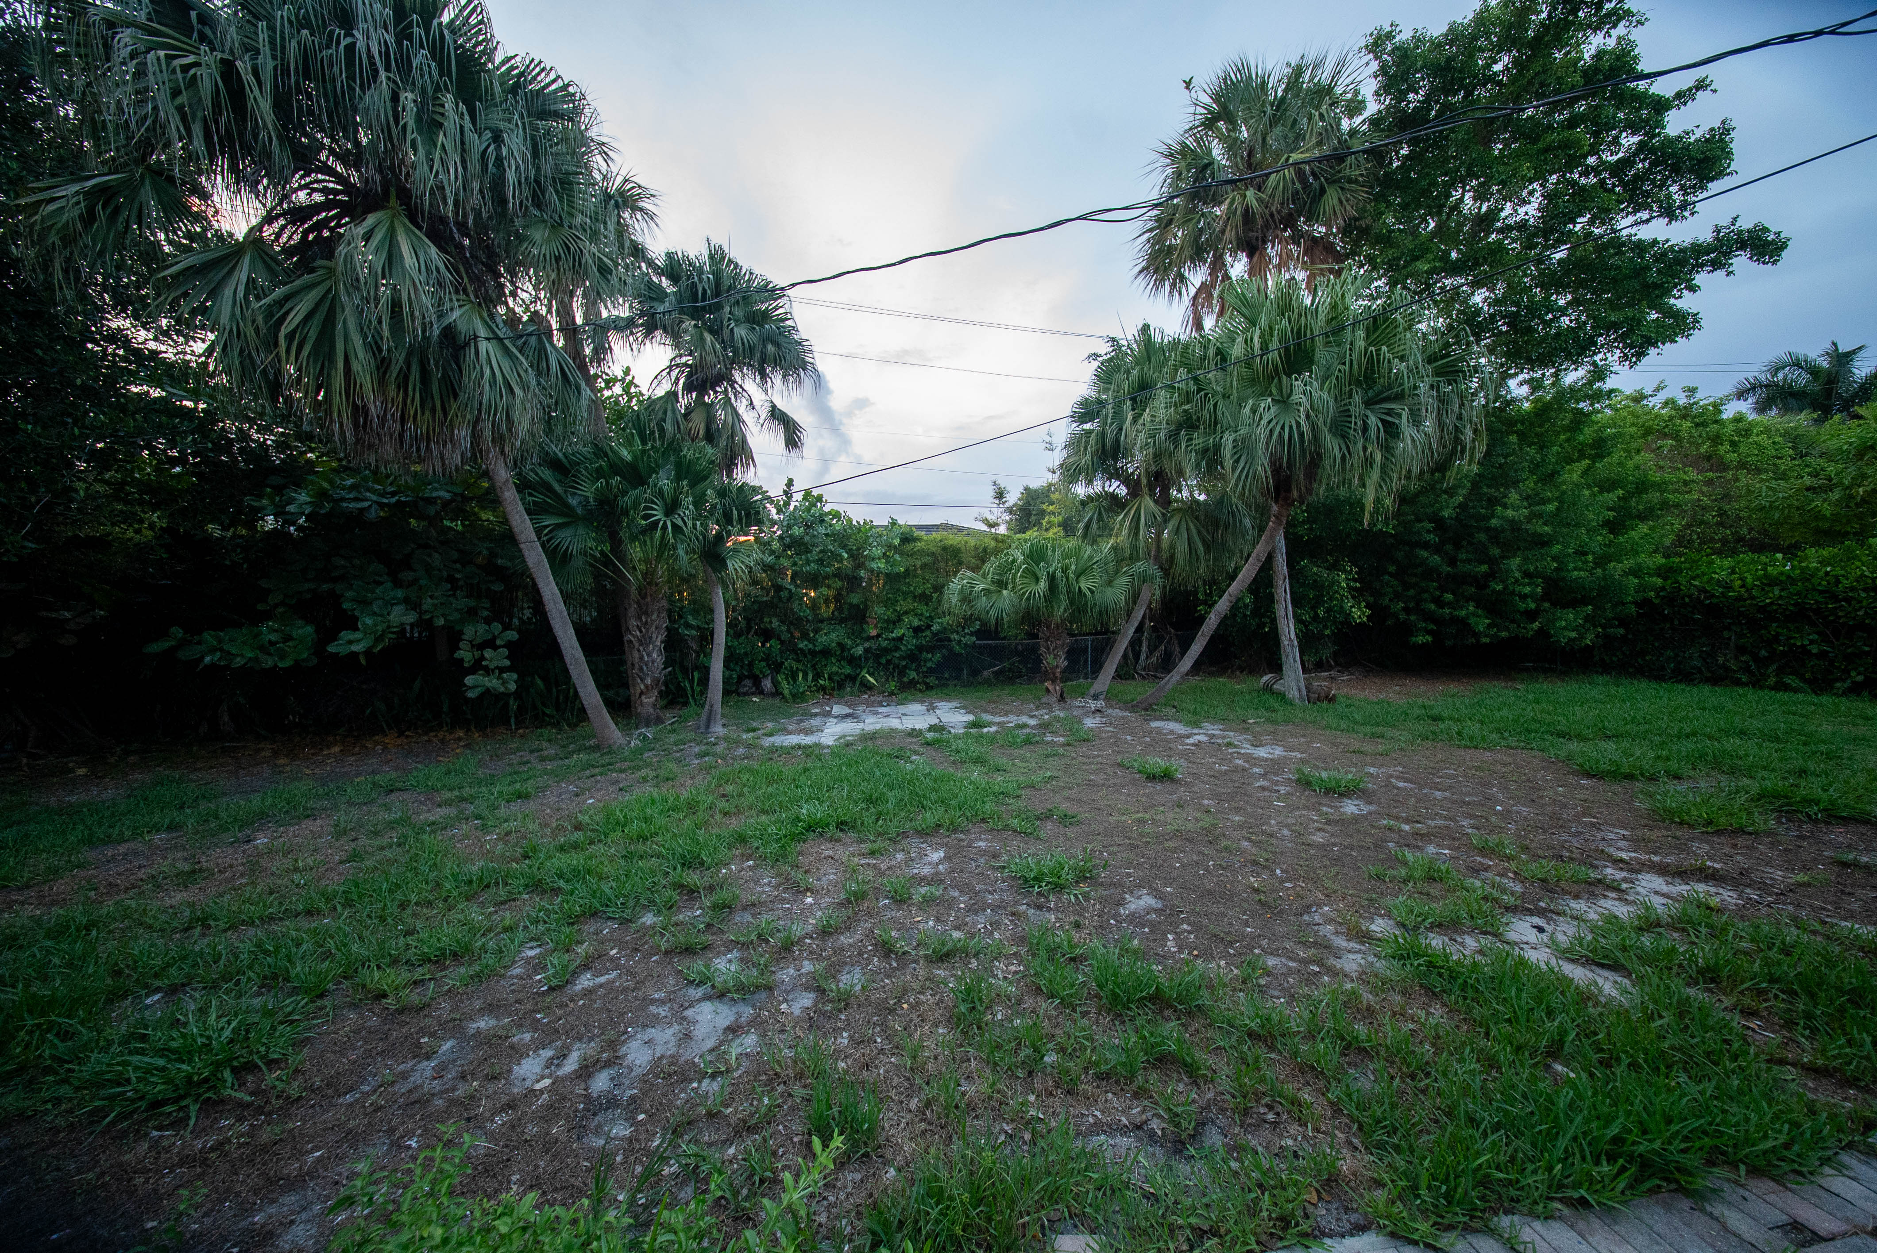
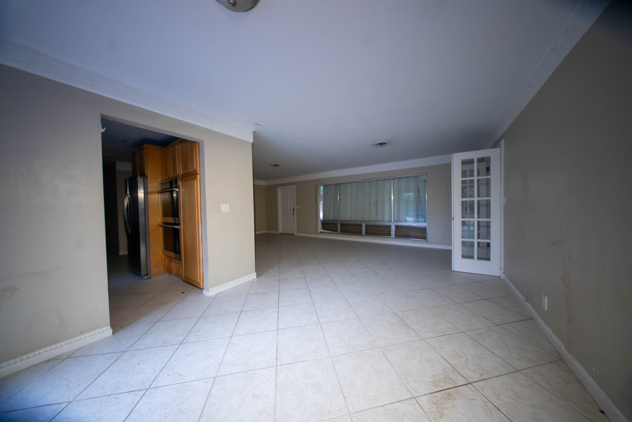
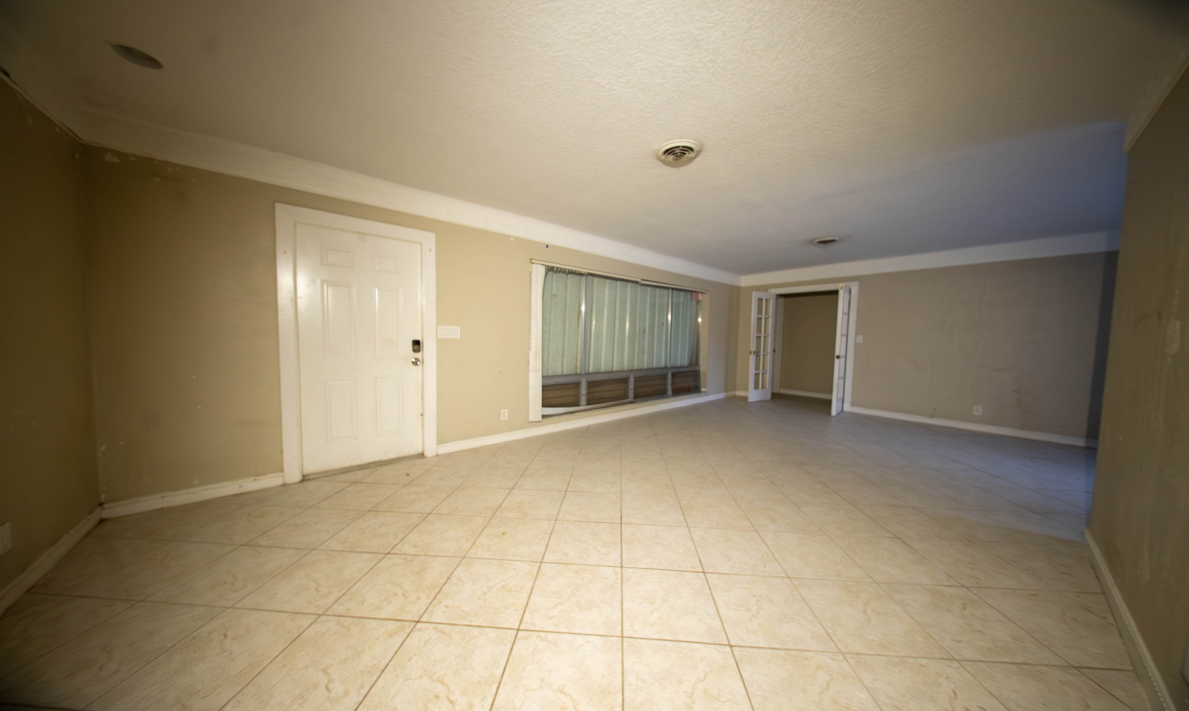
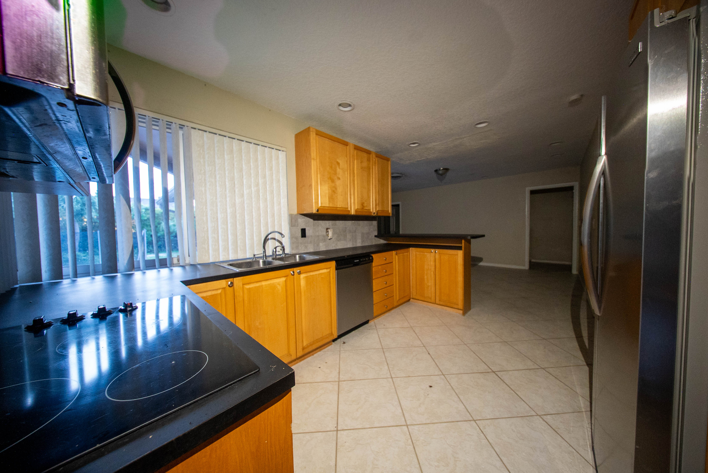
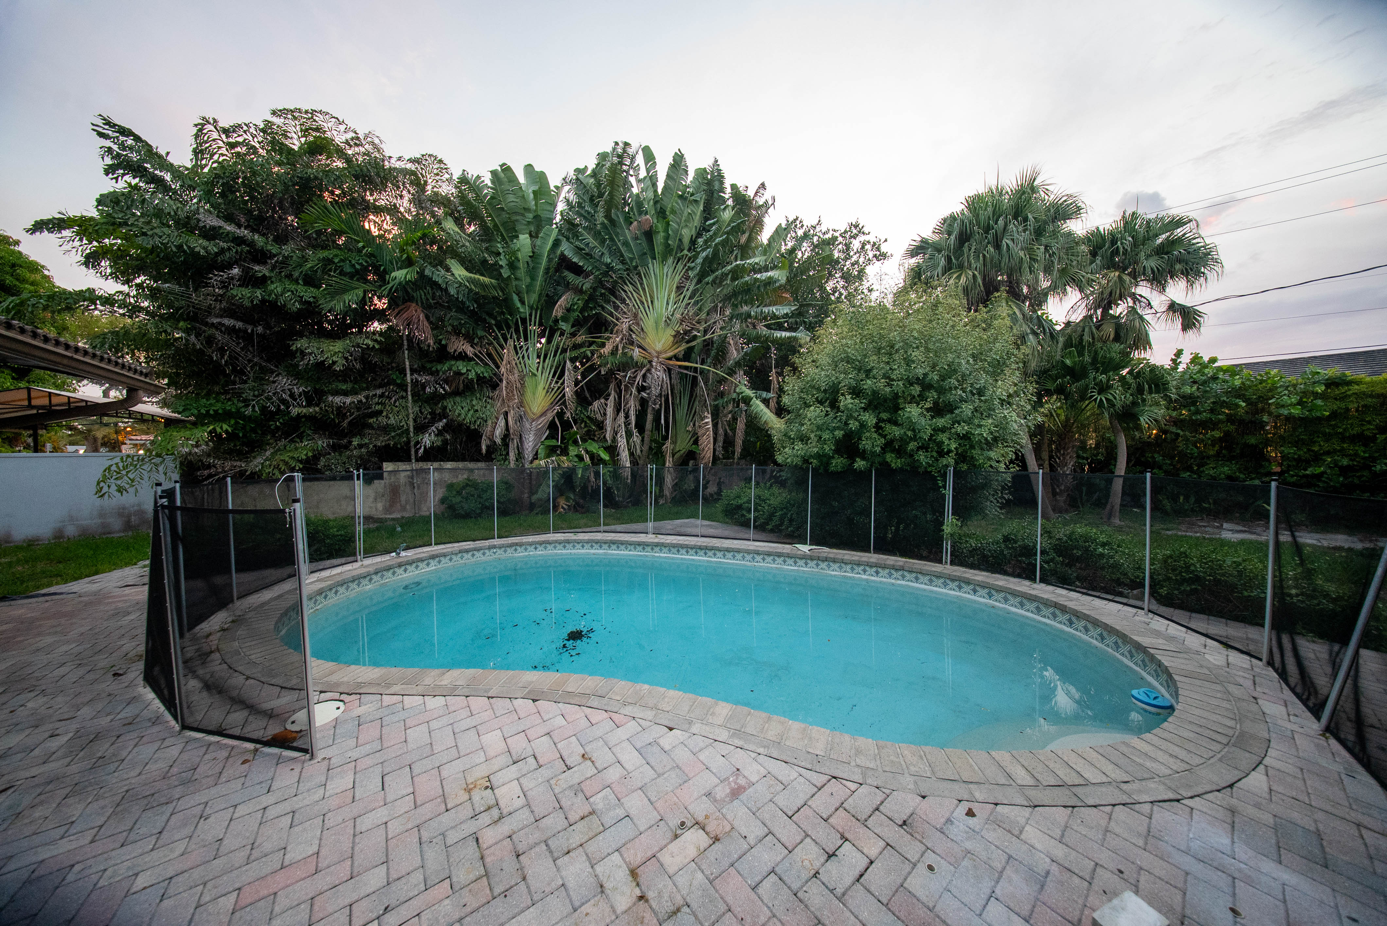
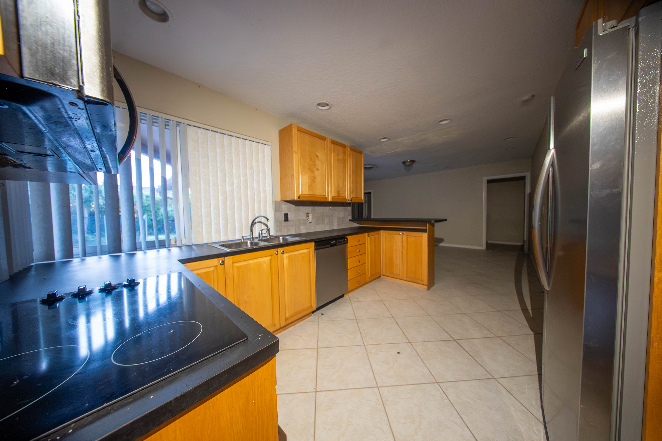
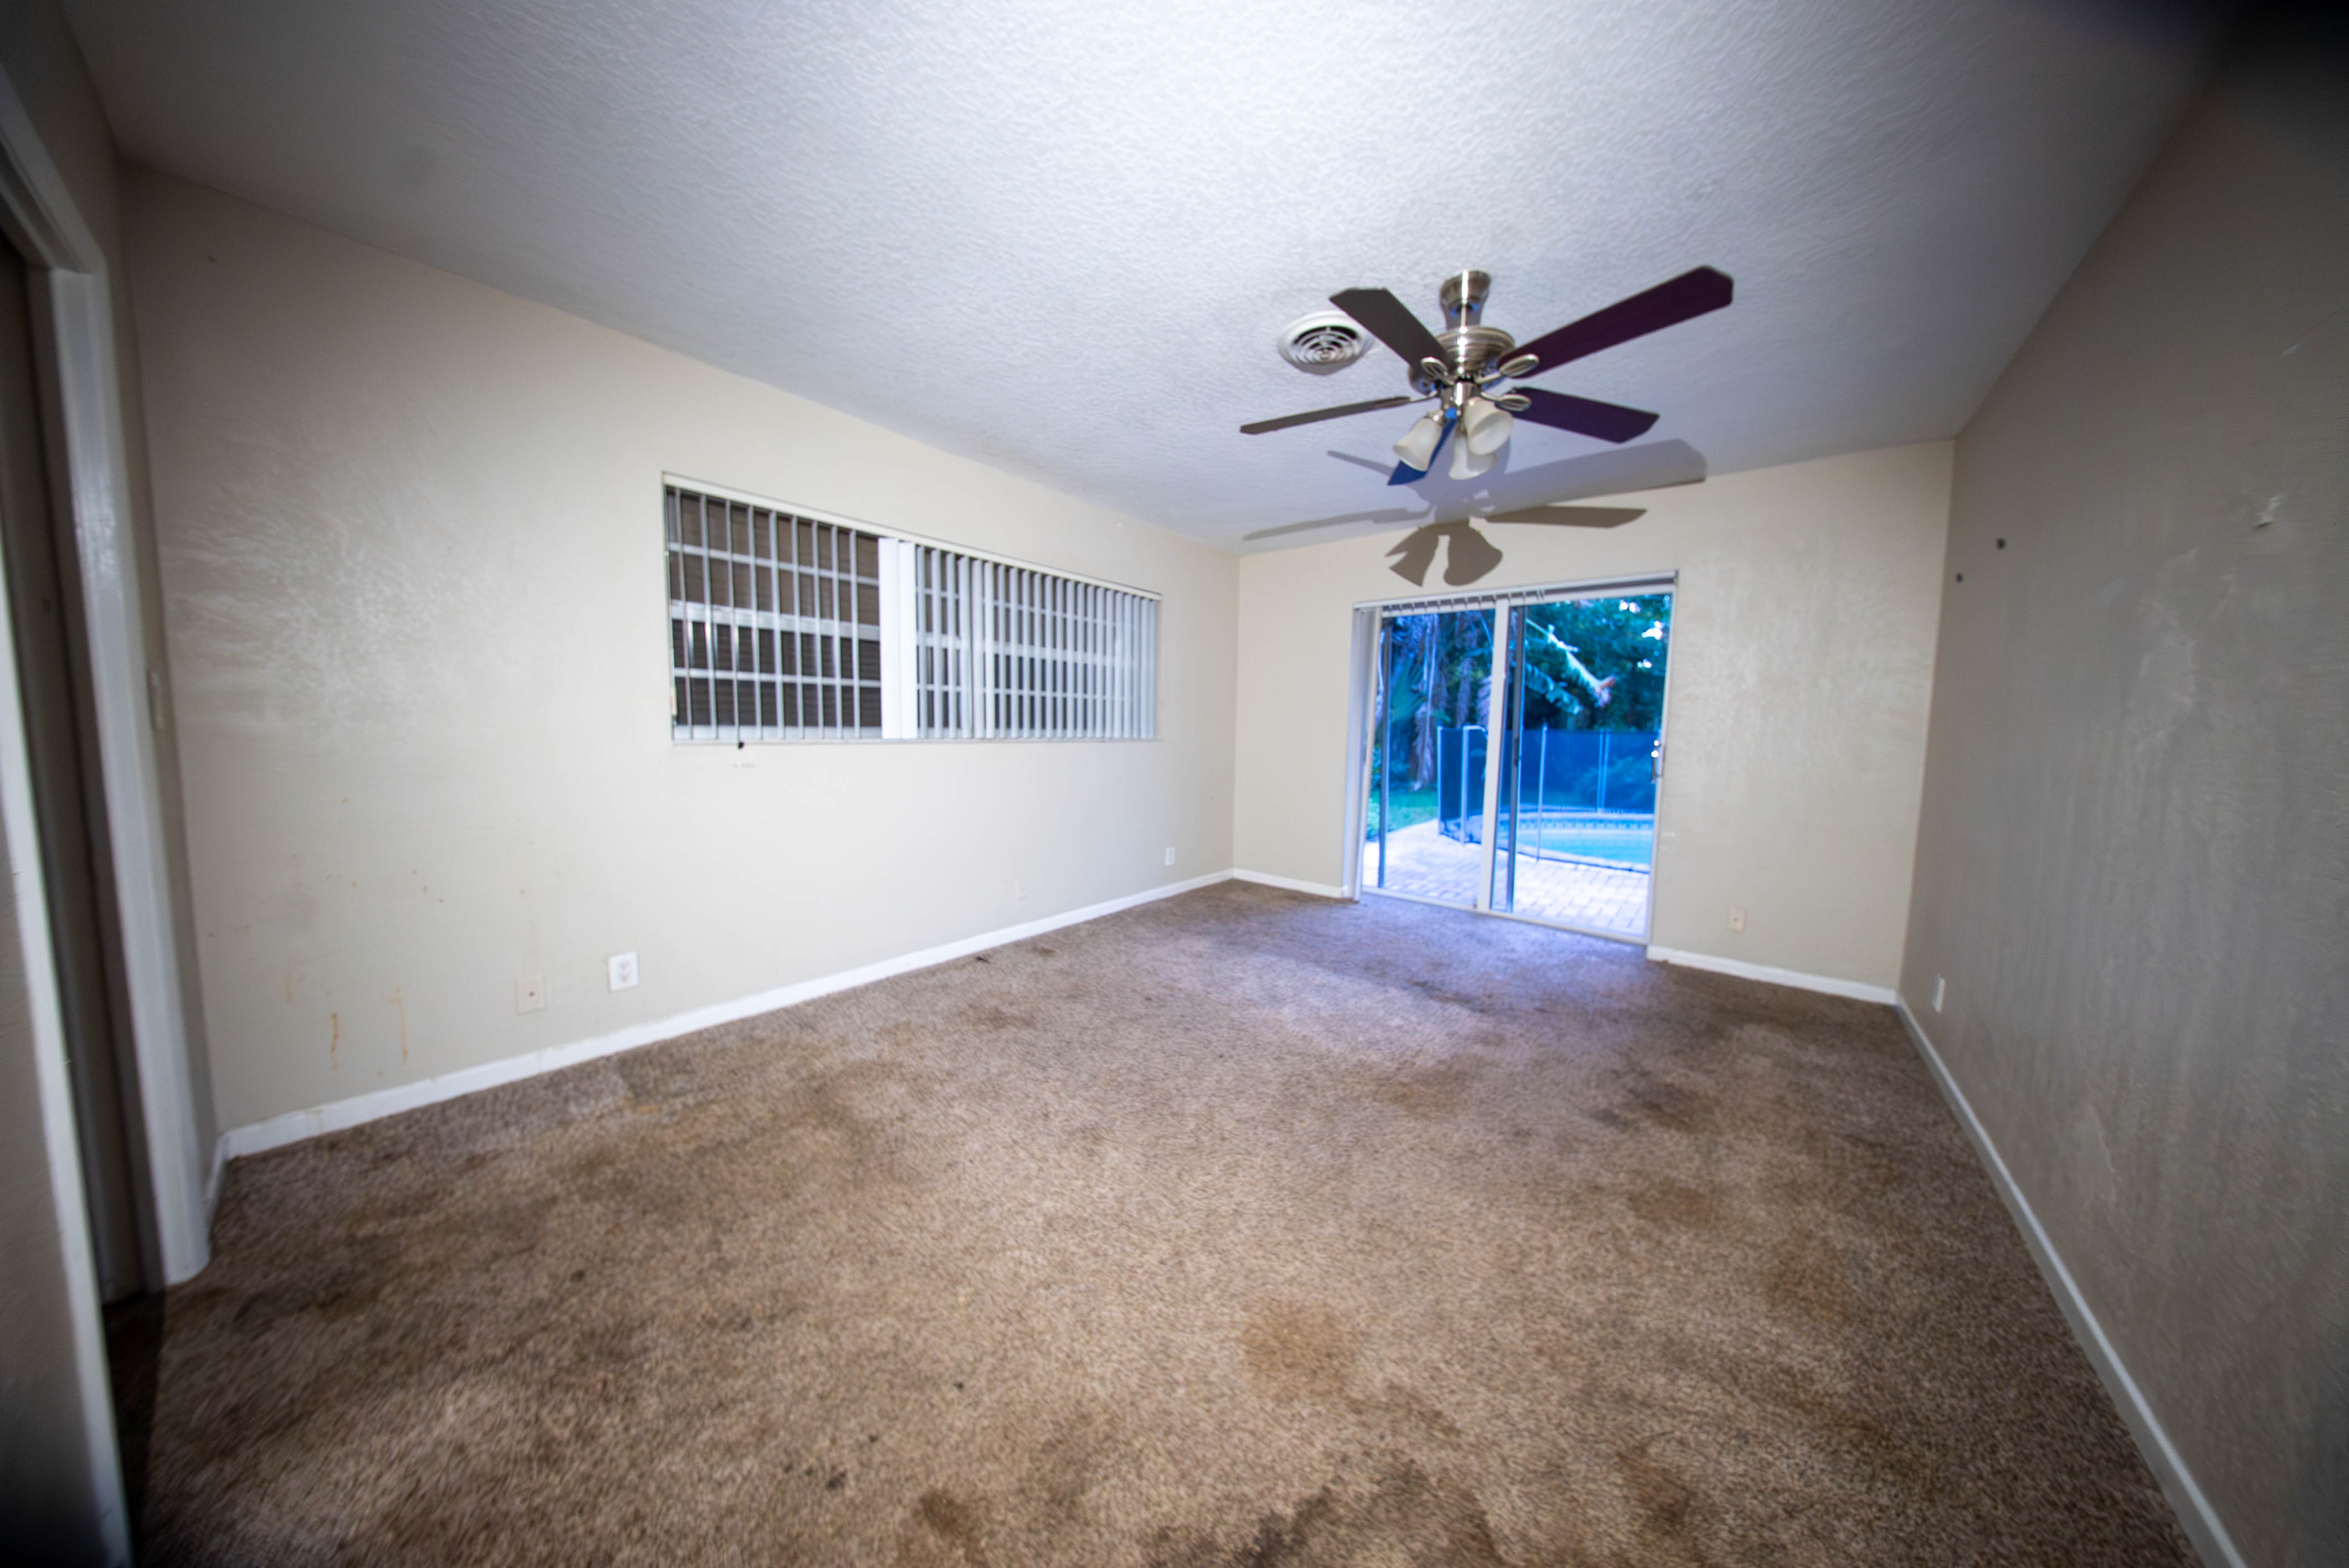
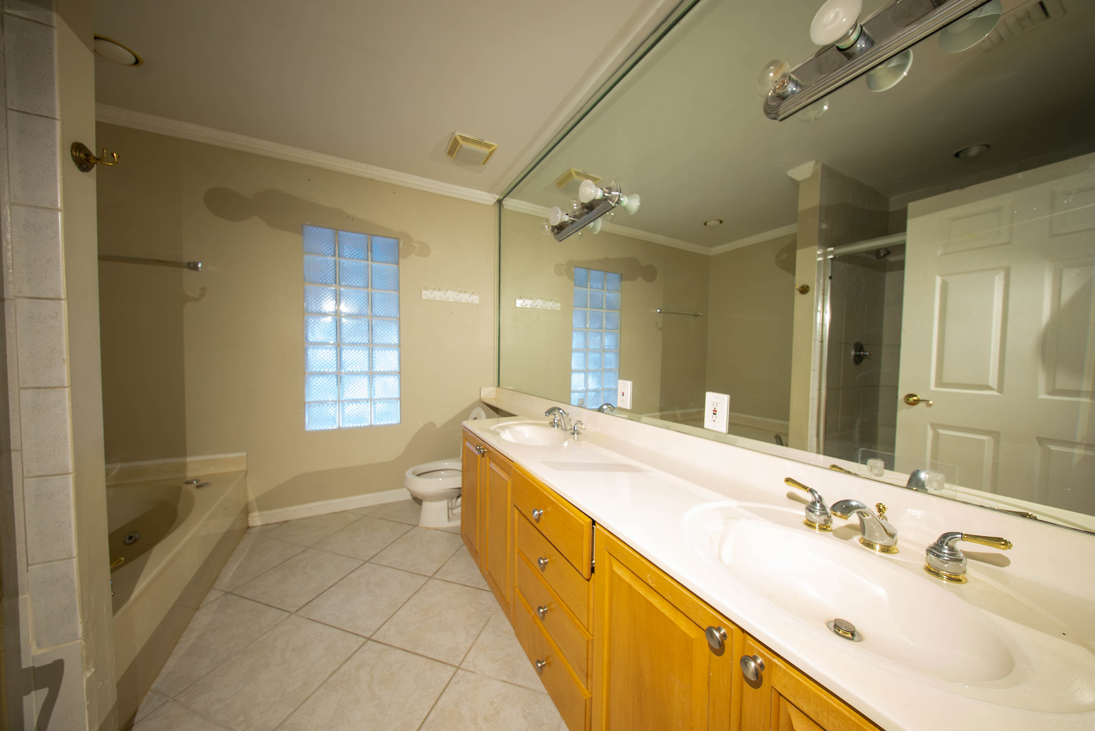
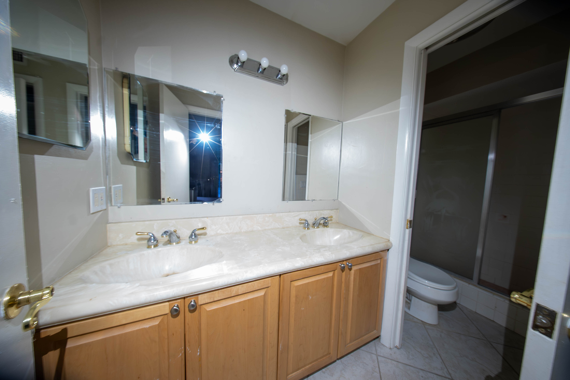
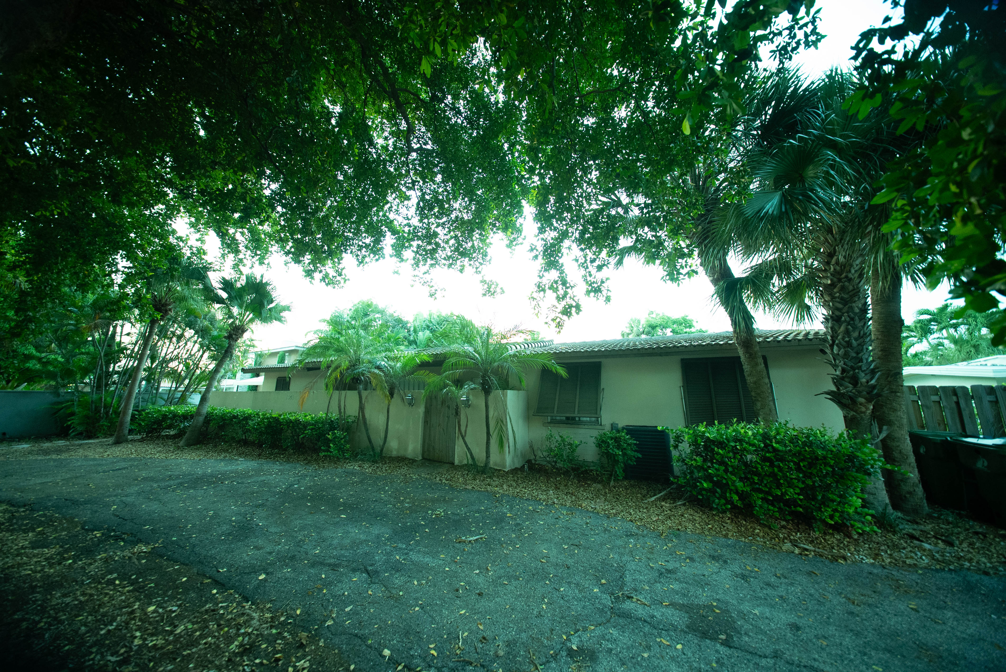
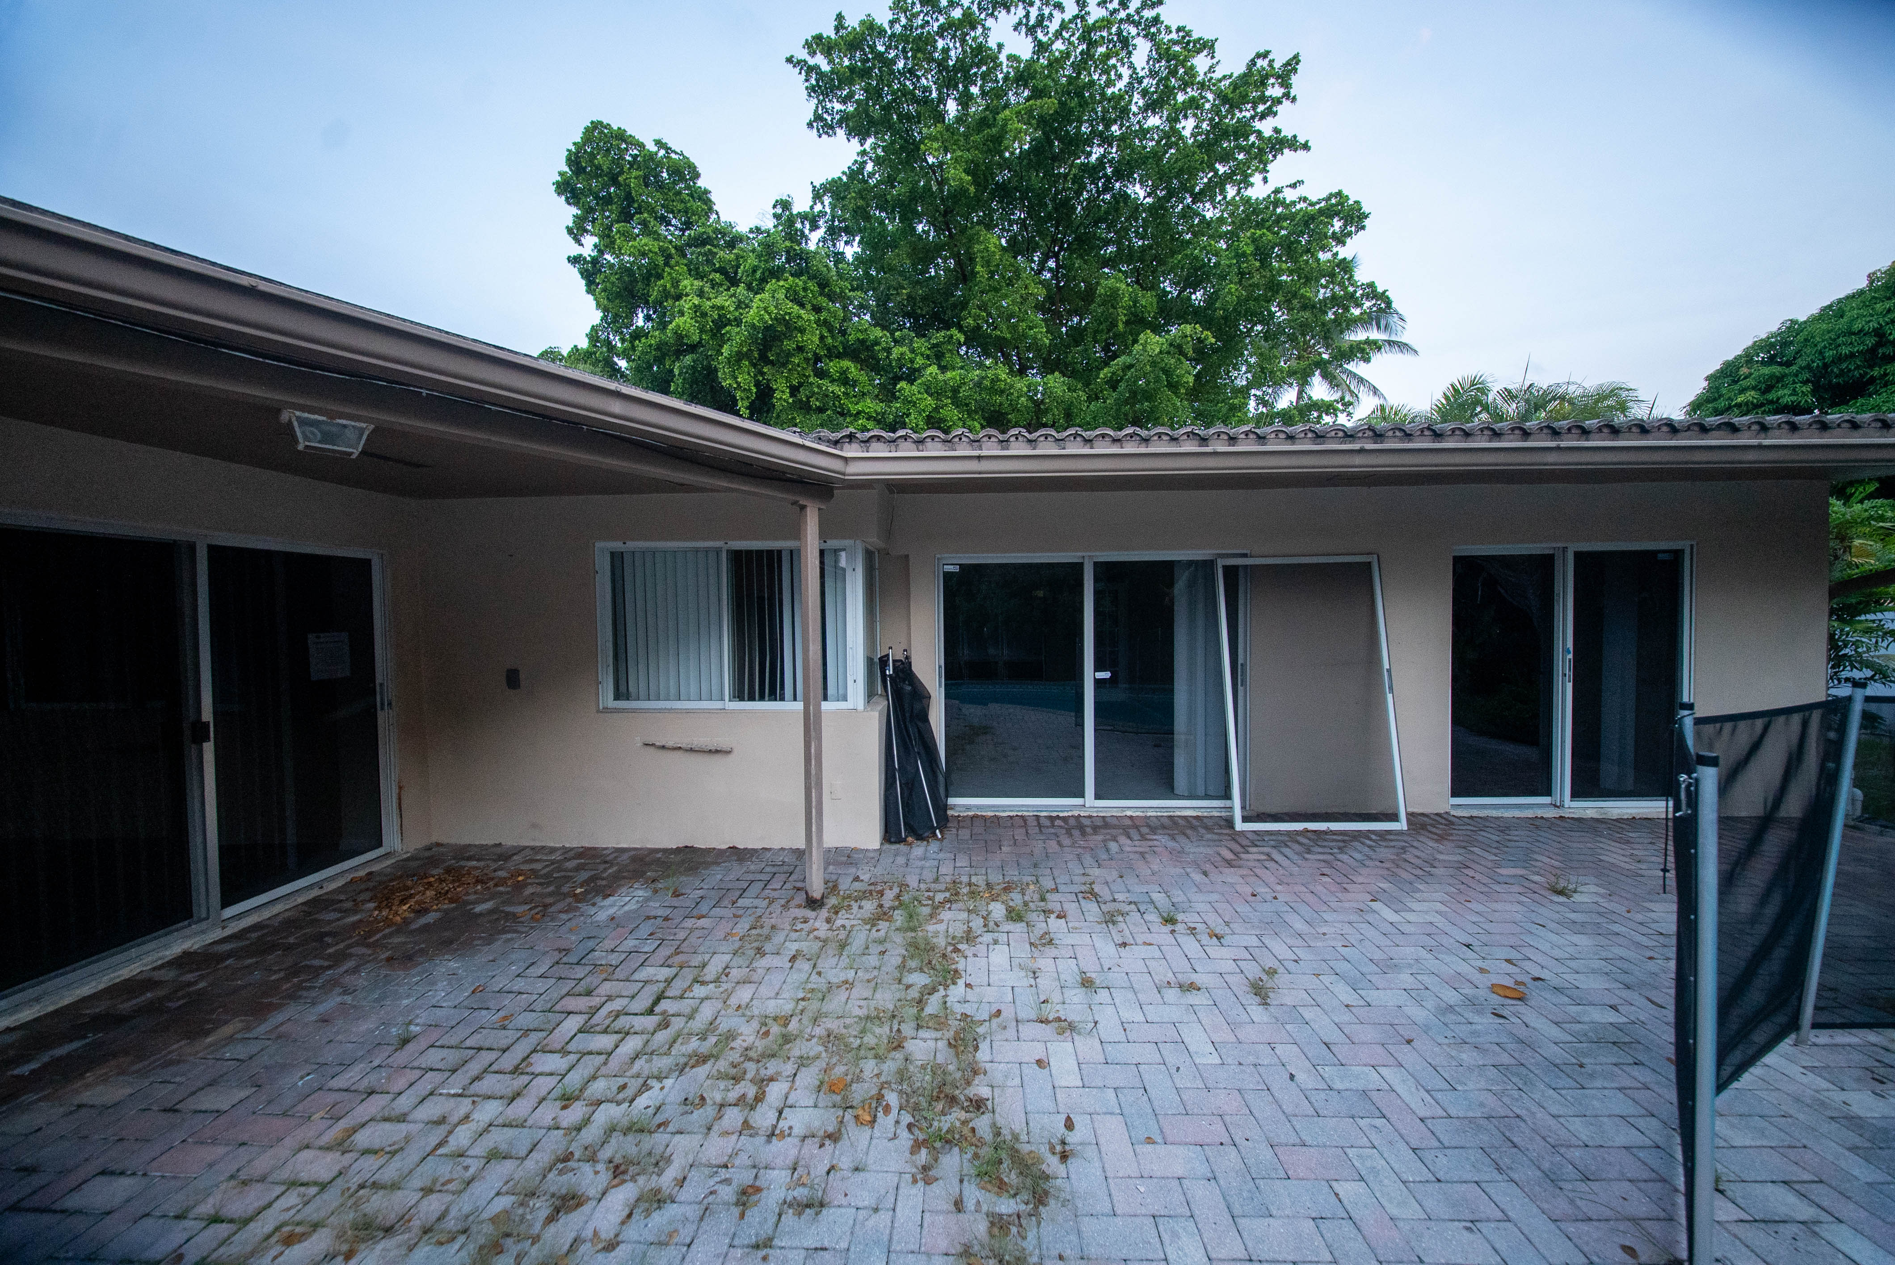
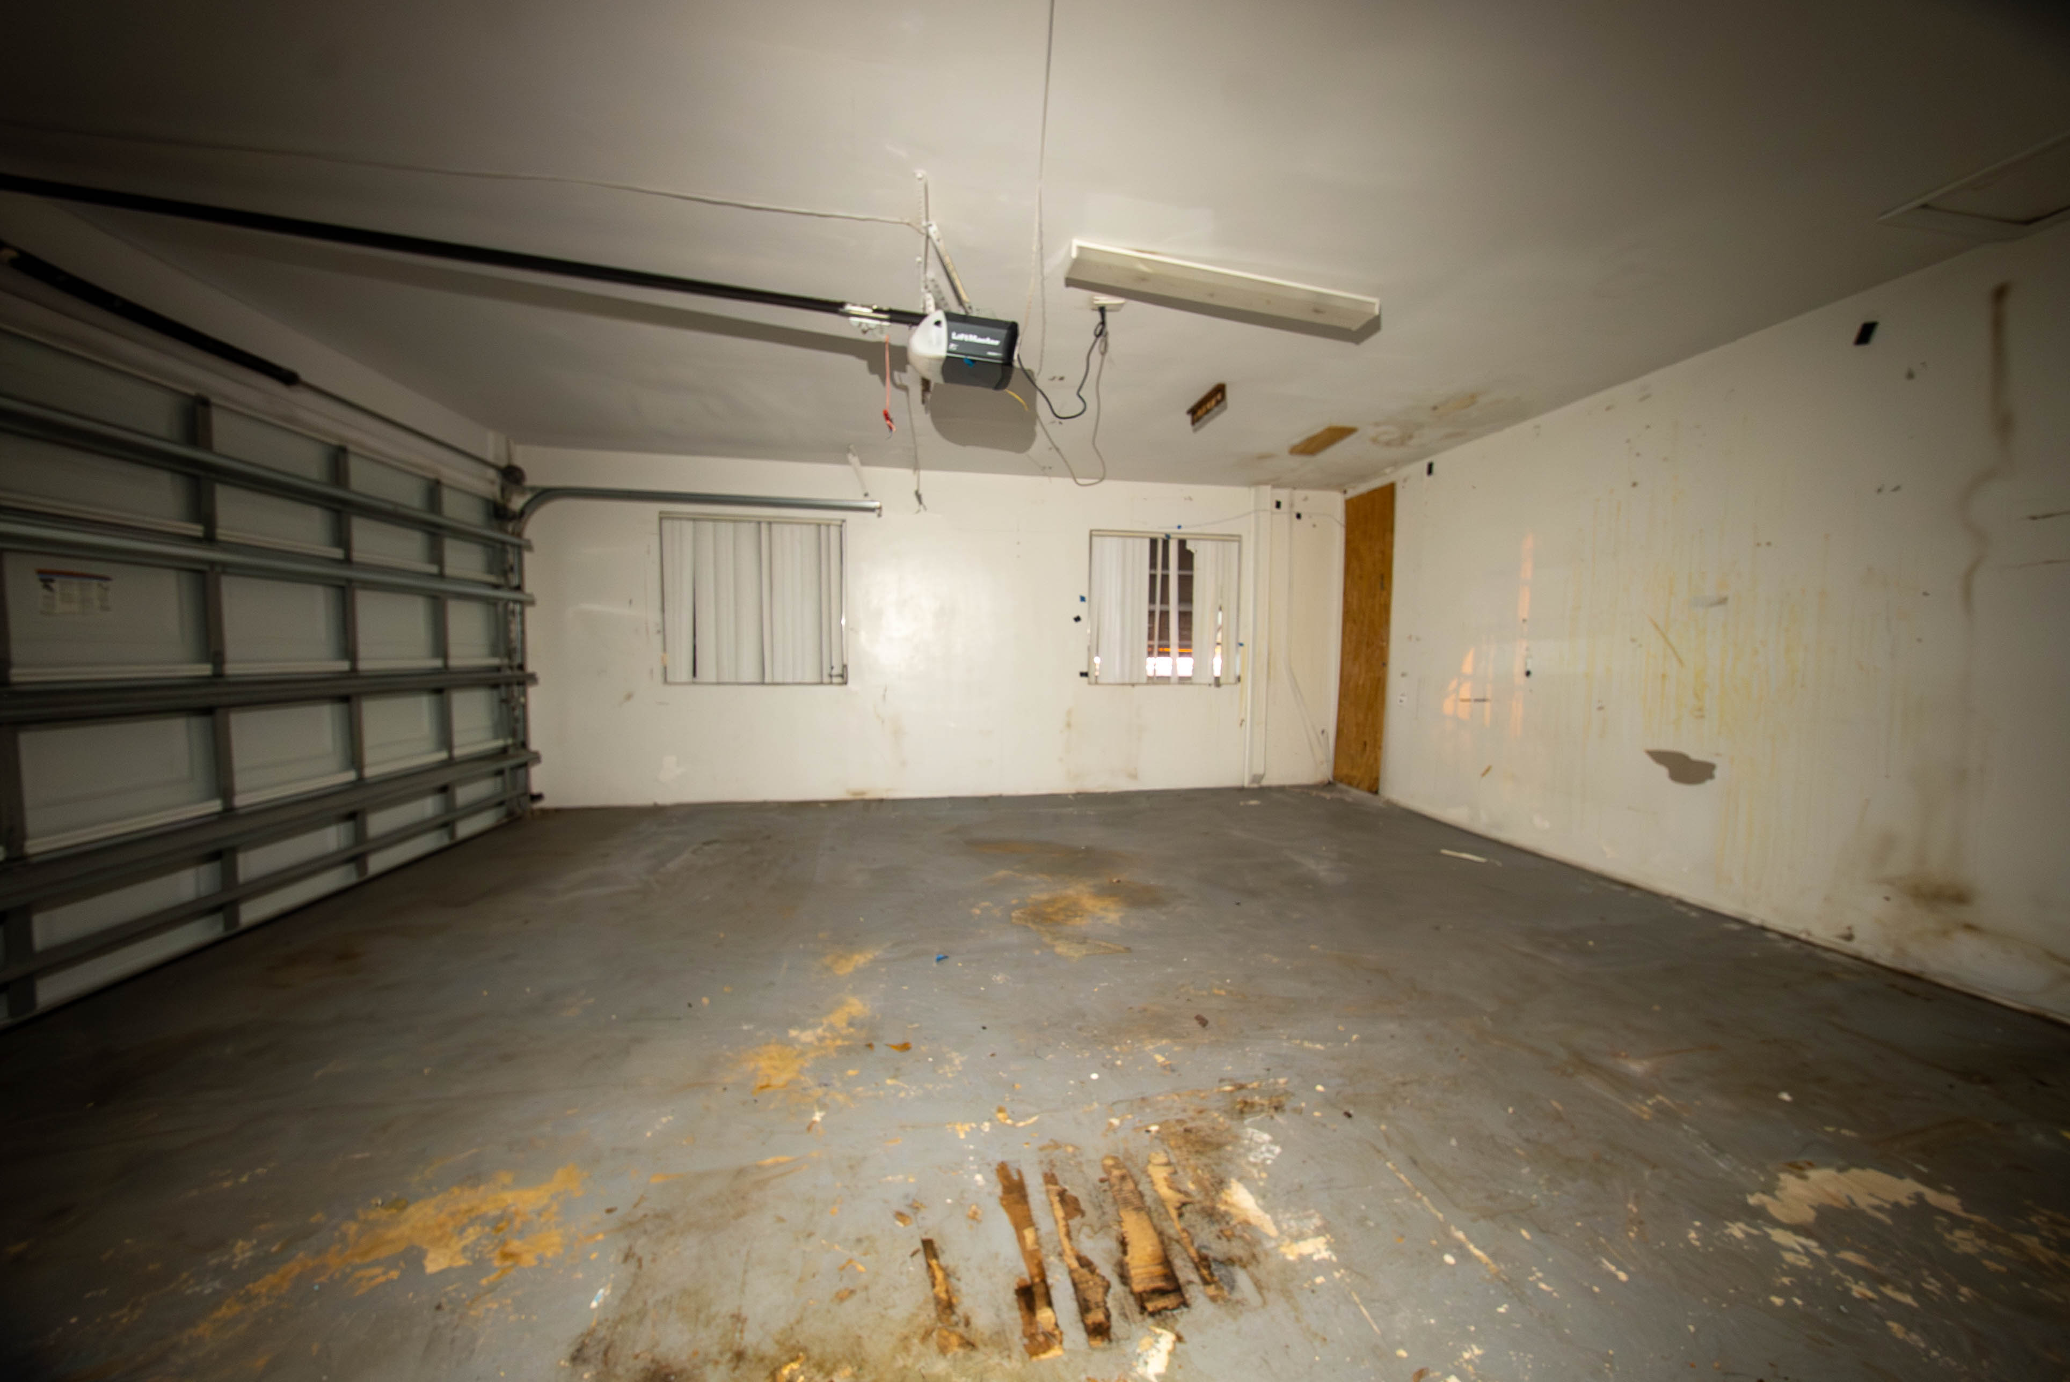
1601 Seabreeze Blvd, Fort Lauderdale, FL 33316 BEFORE
ARCSA CAPITAL | Confidential | For Qualified Investors Only

Slide 7
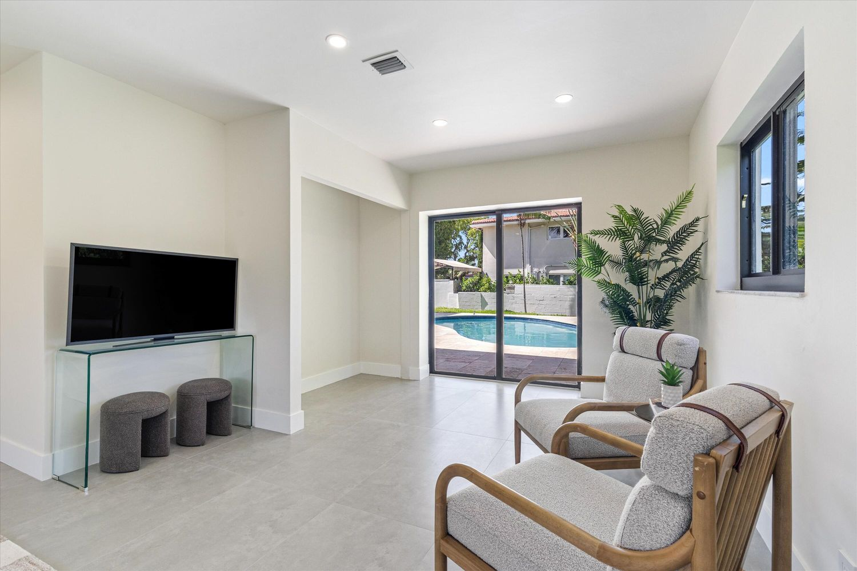
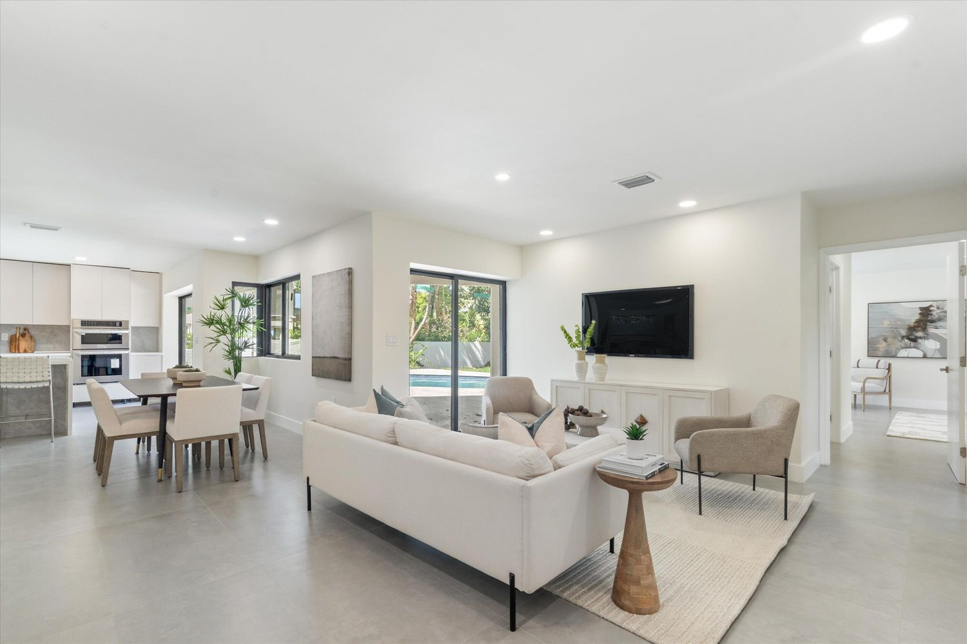
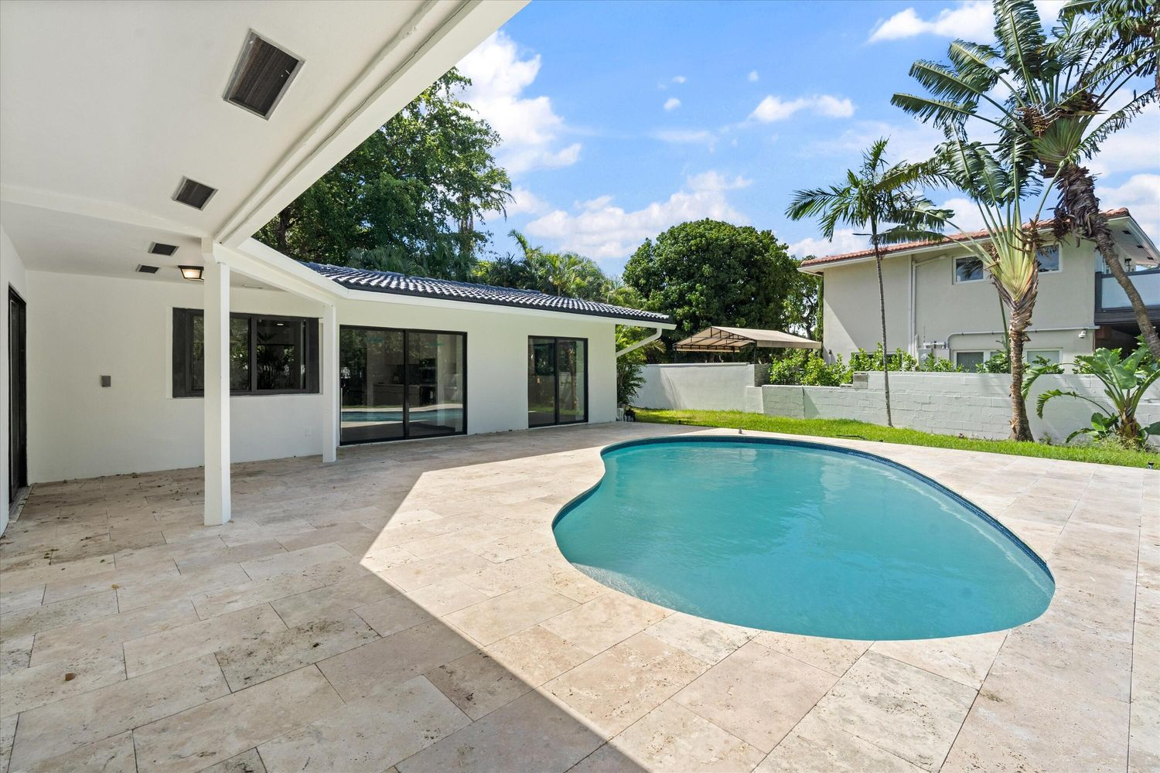
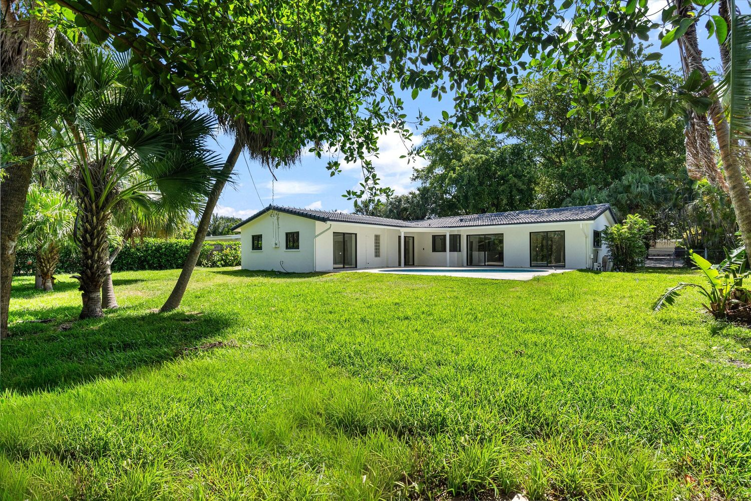
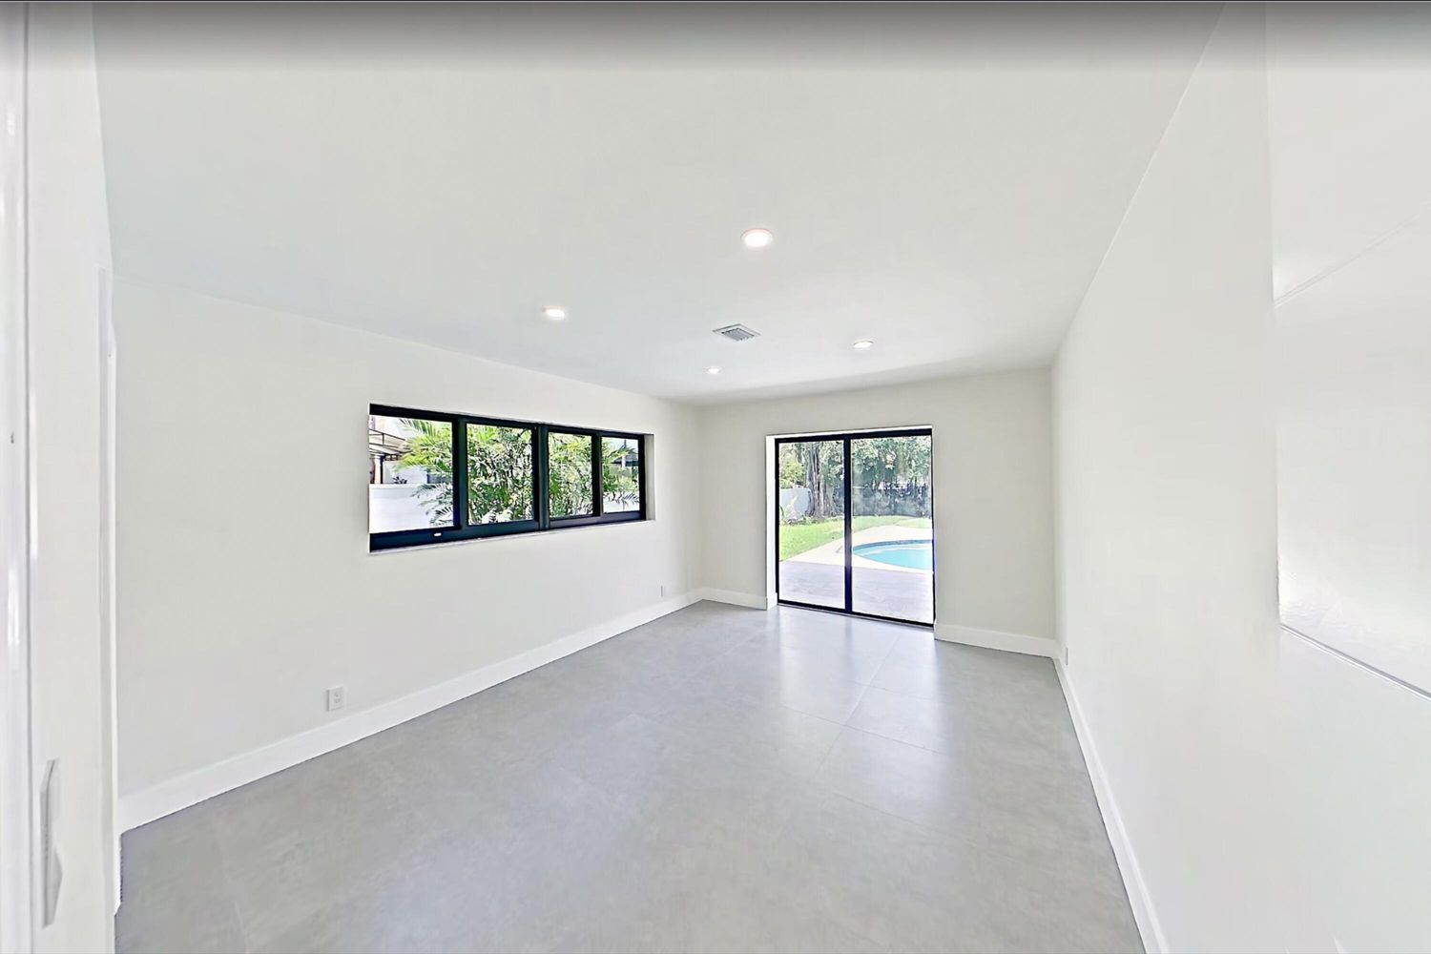
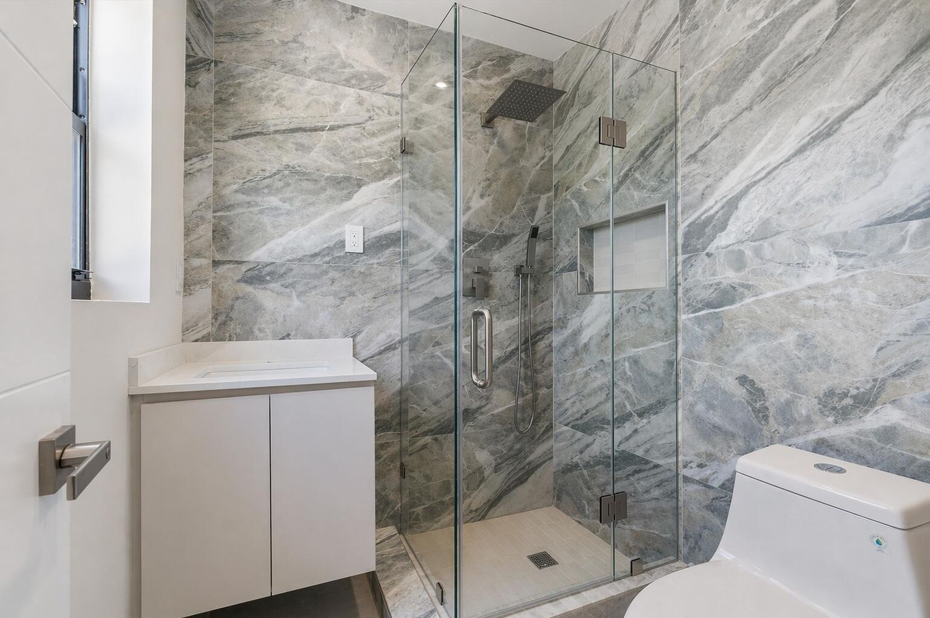
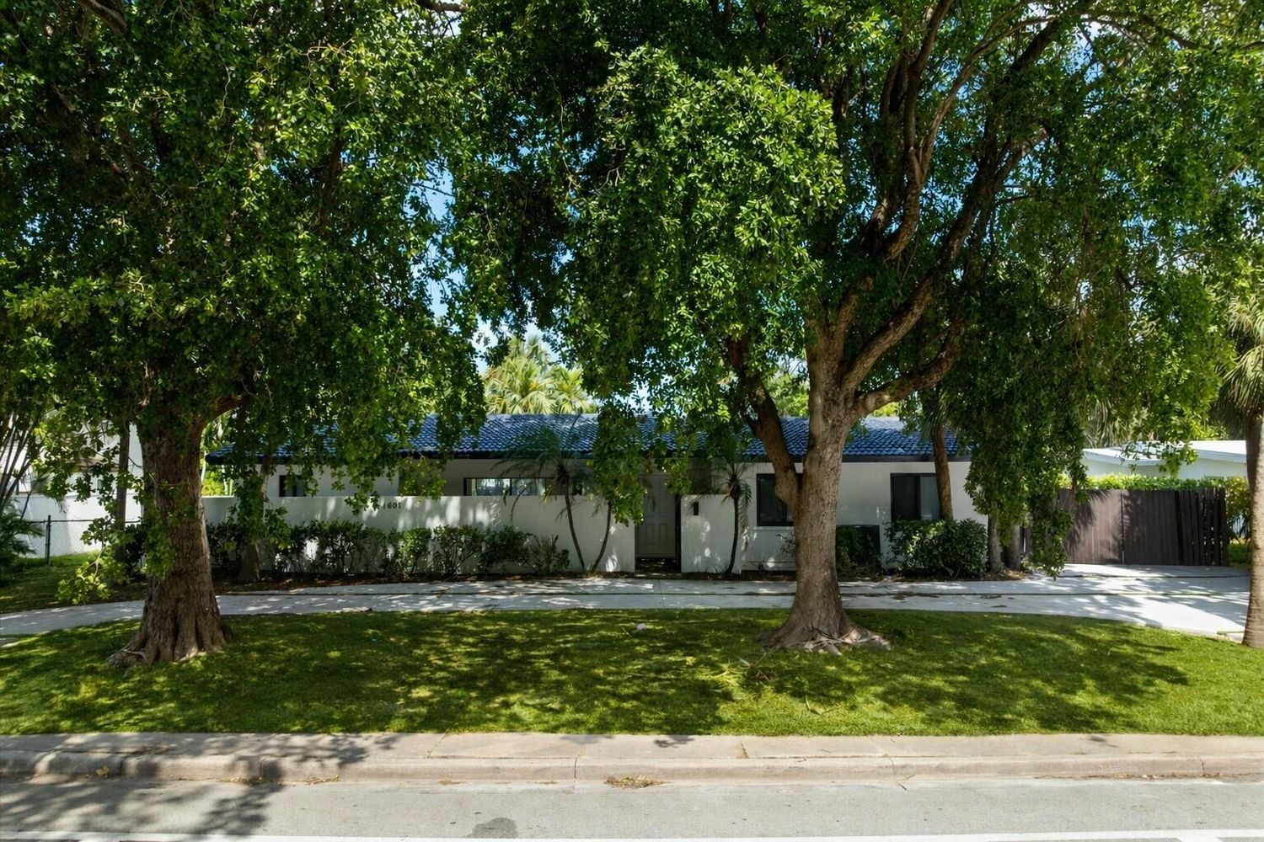
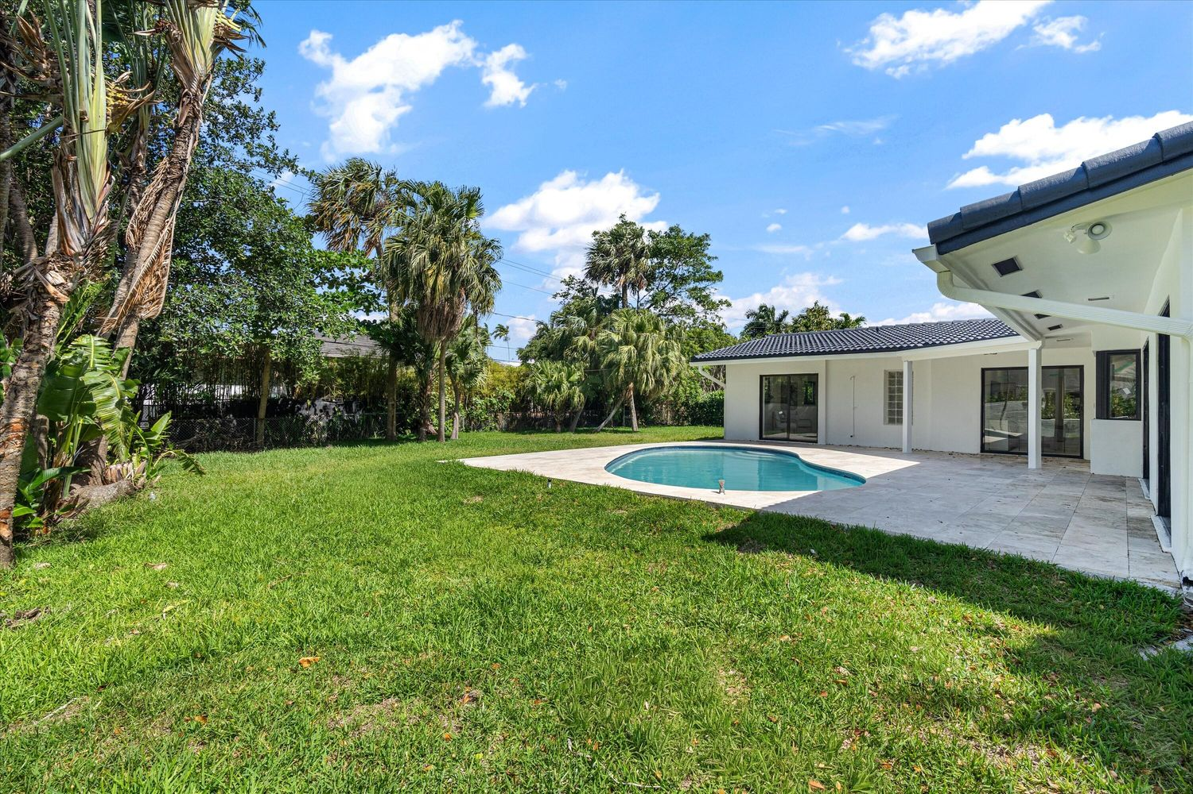
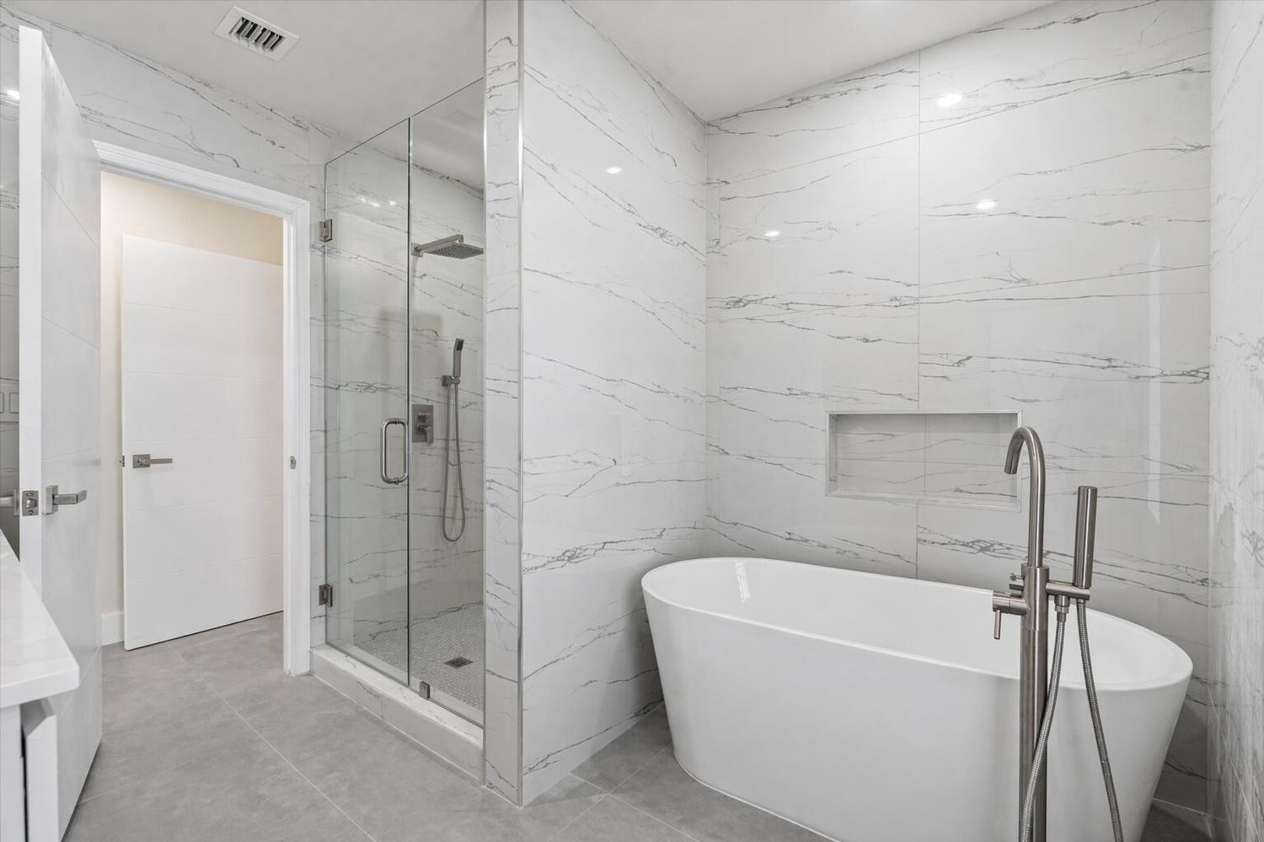
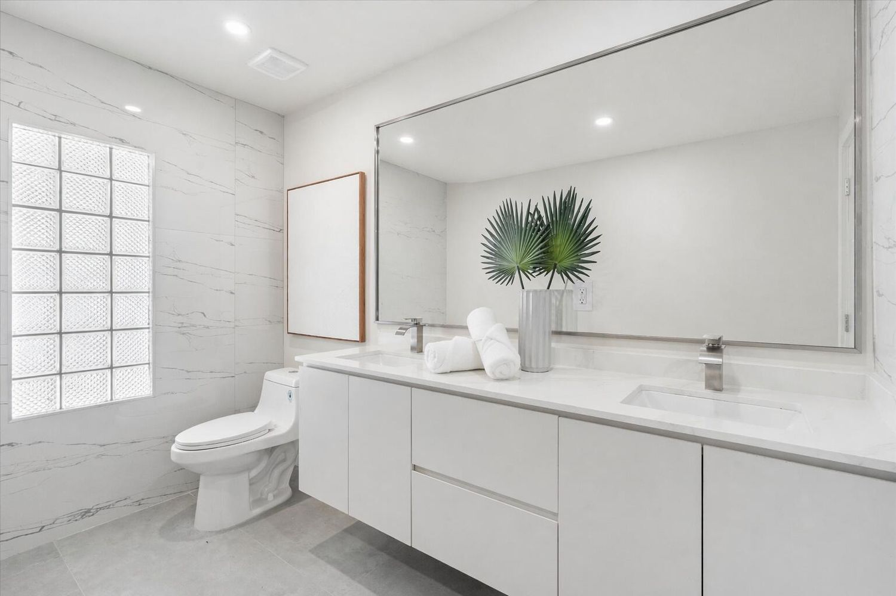
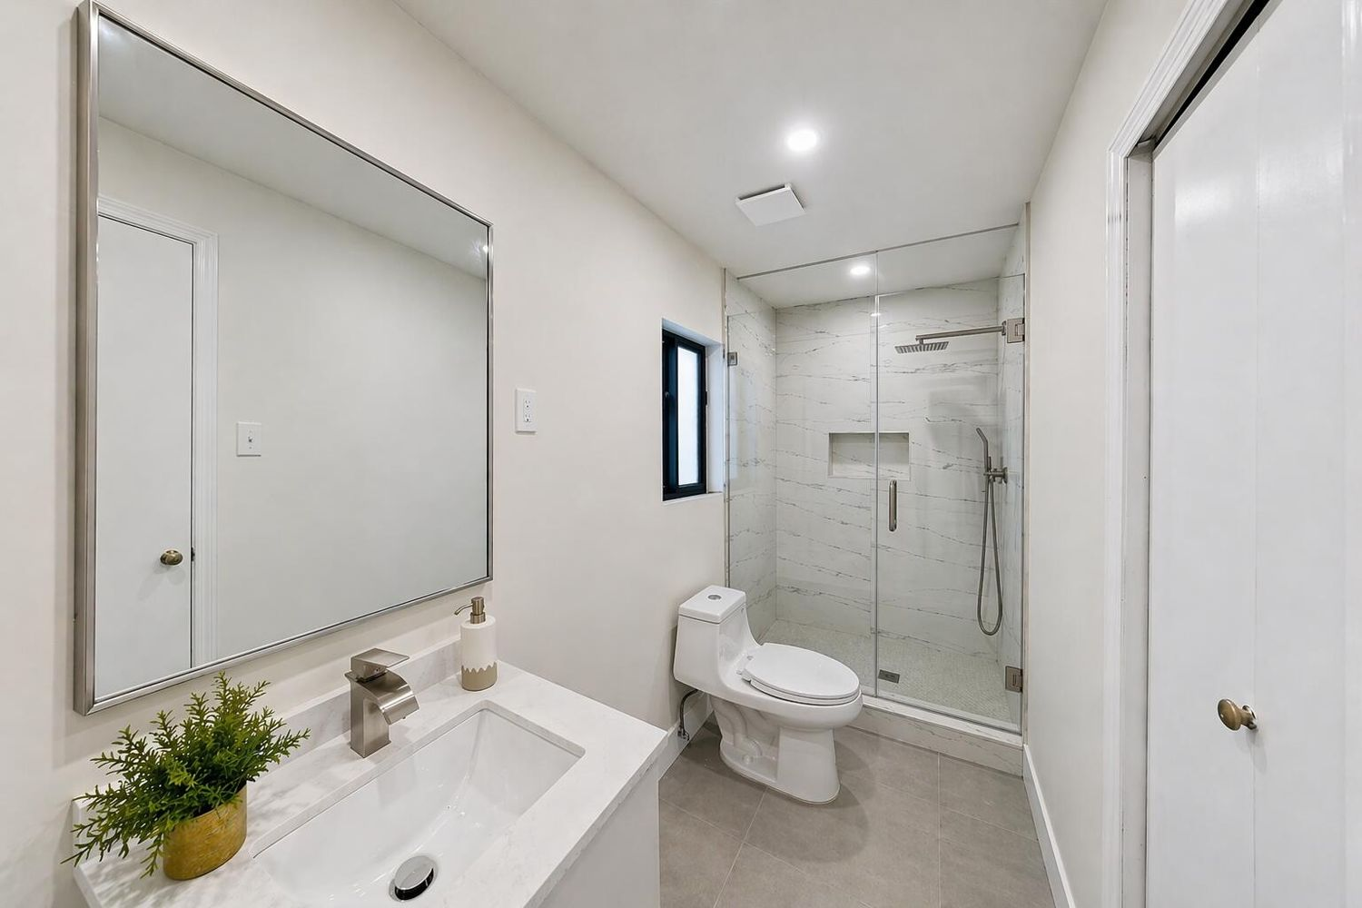
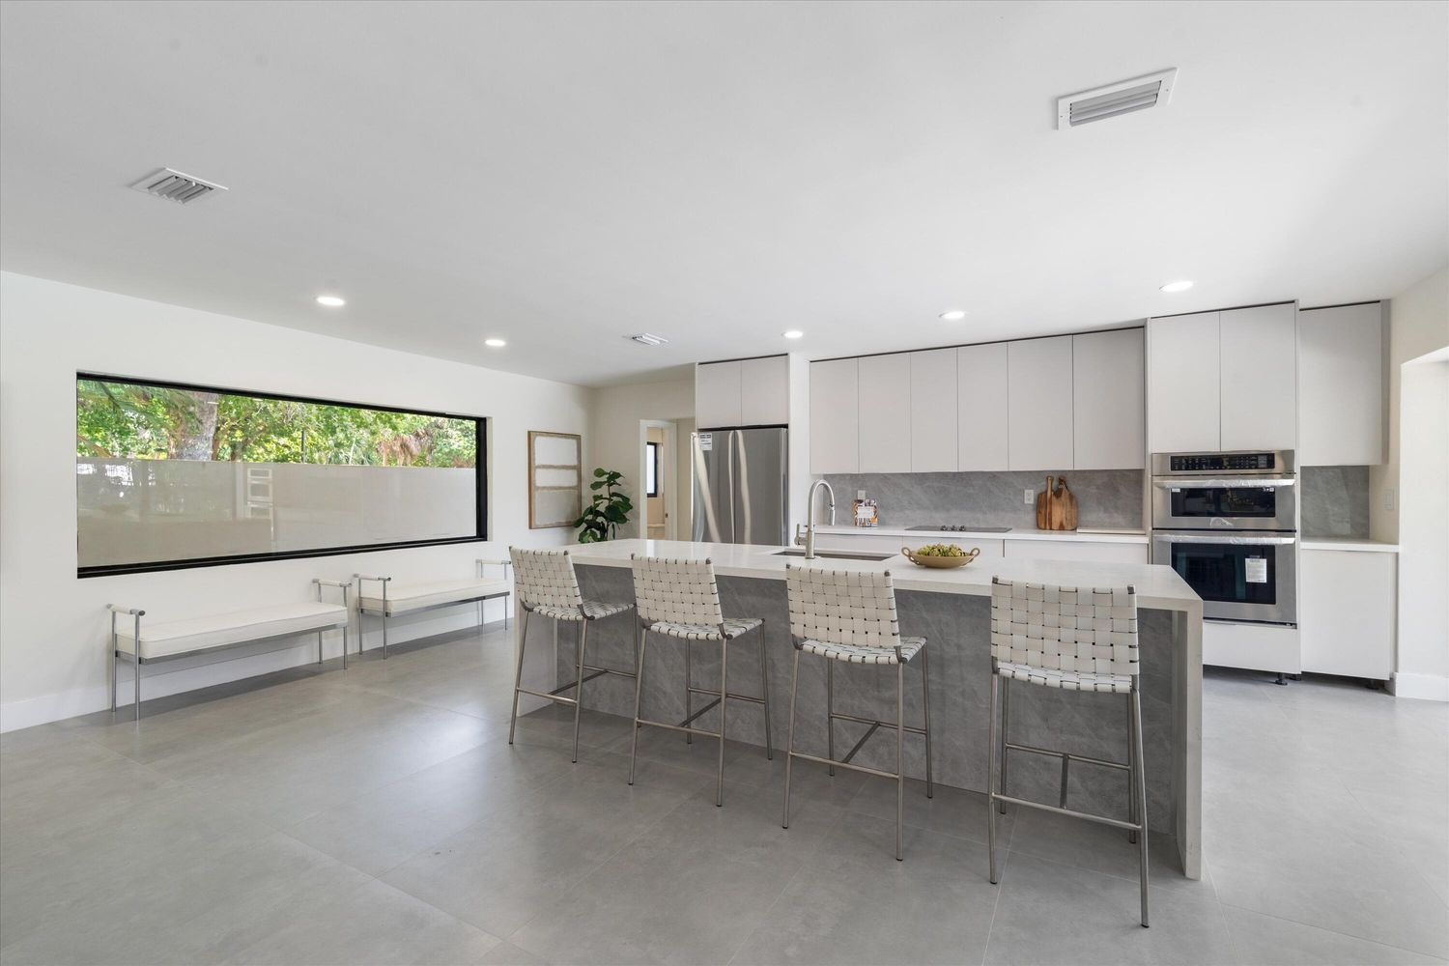
1601 Seabreeze Blvd, Fort Lauderdale, FL 33316 AFTER
ARCSA CAPITAL | Confidential | For Qualified Investors Only

Slide 8
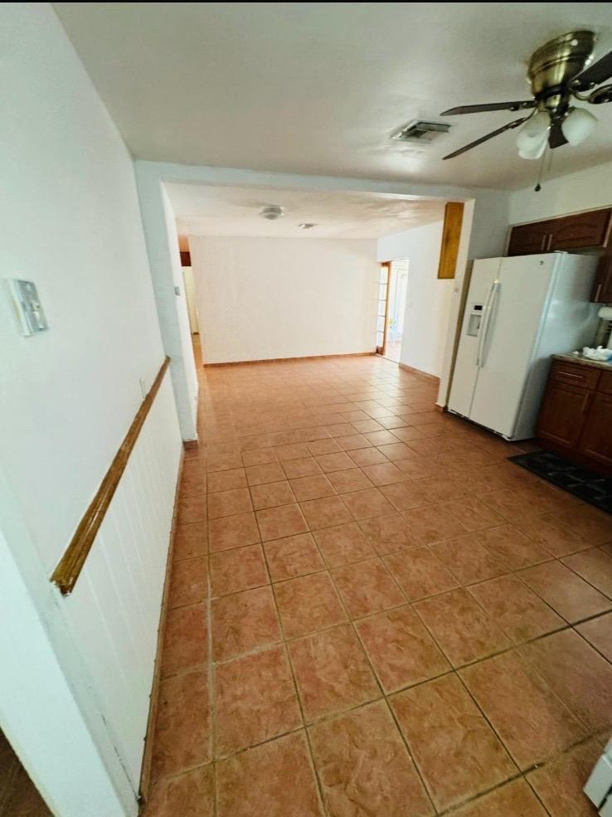
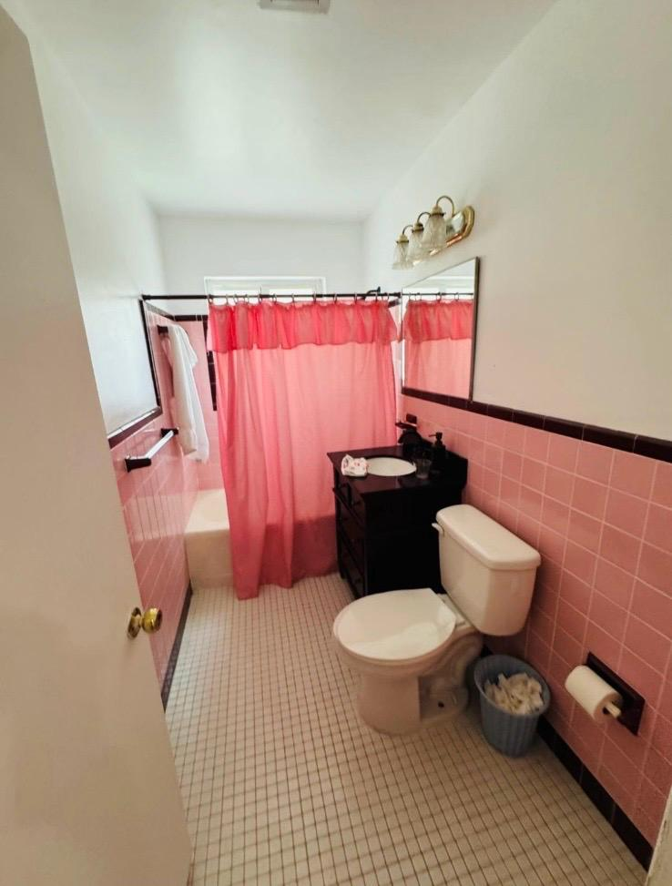
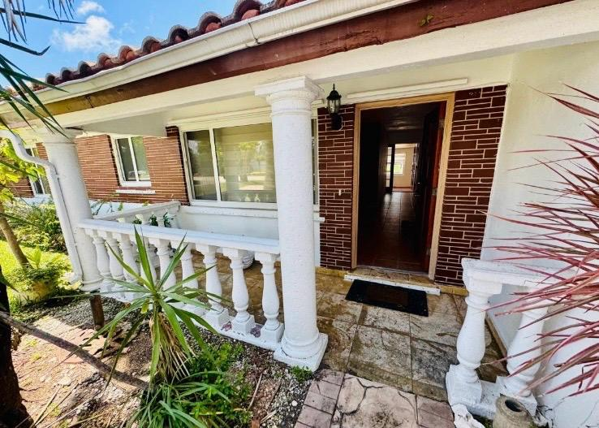
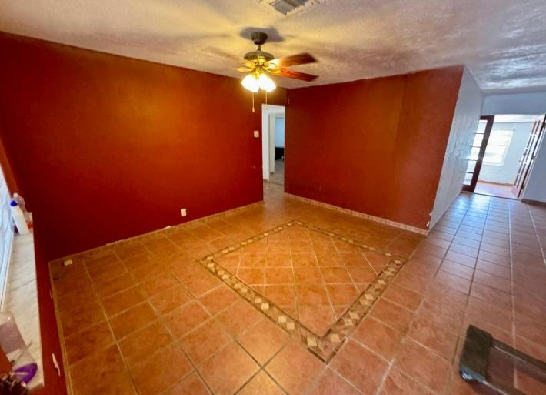
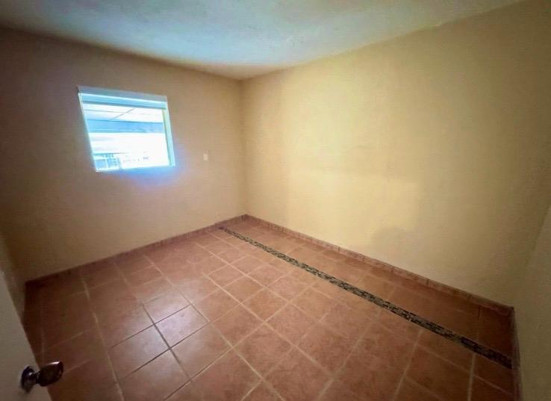
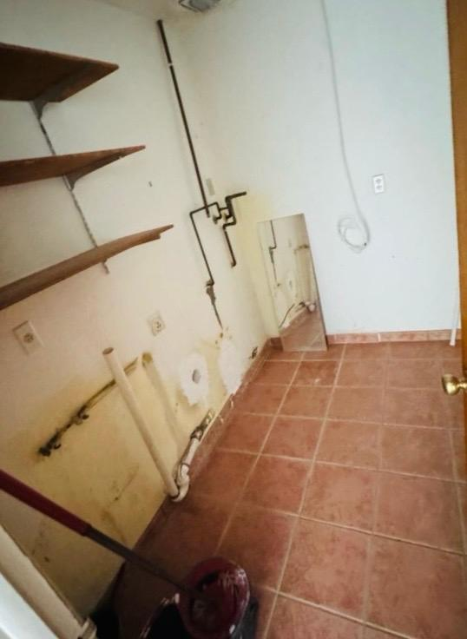
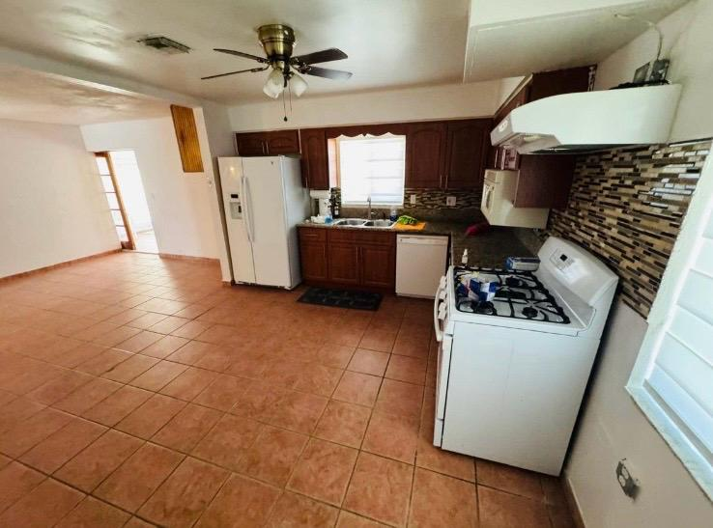
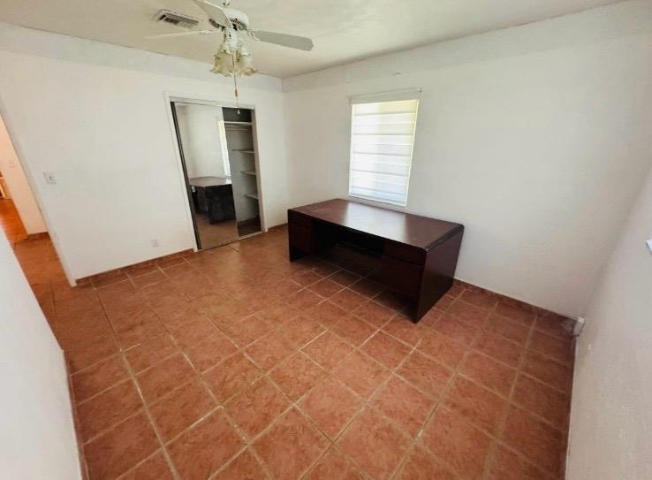
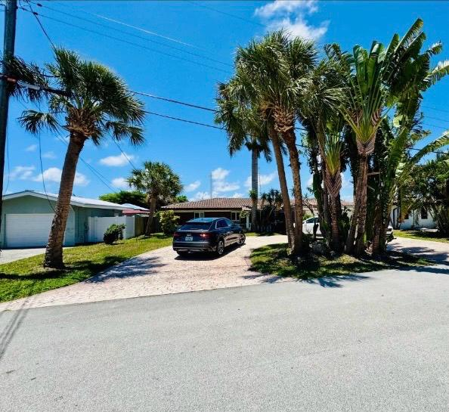
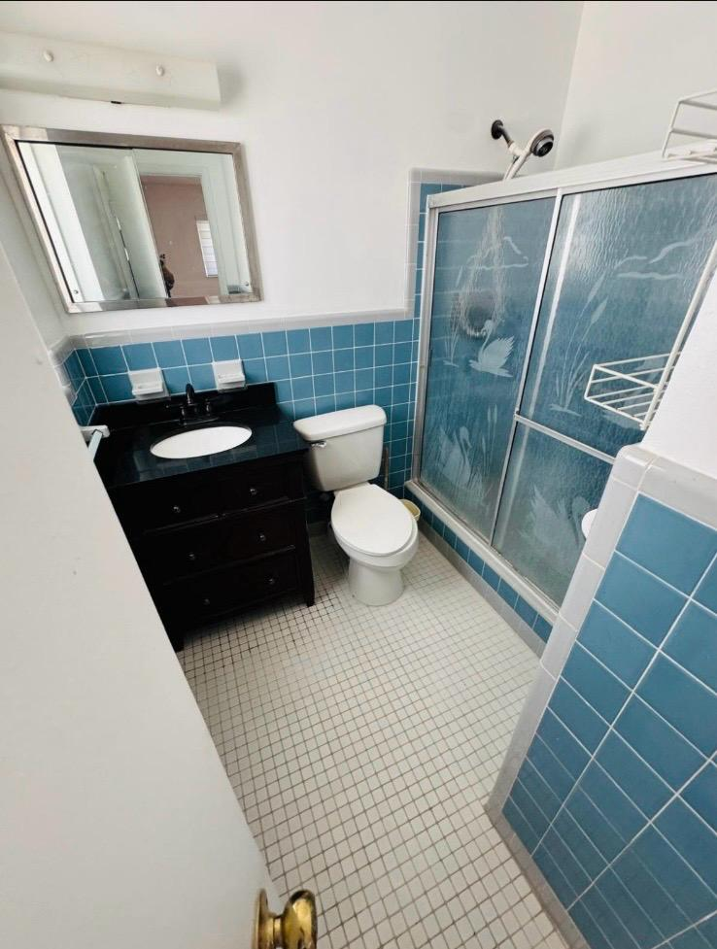
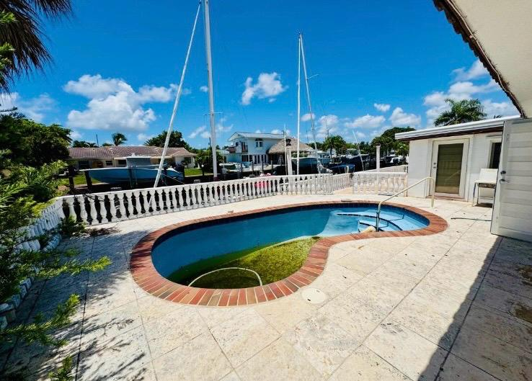
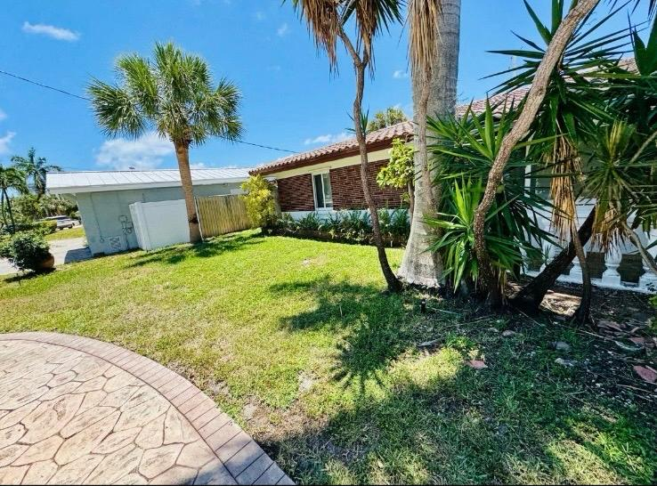
2280 SE 10th Ct Pompano Beach, FL 33062 BEFORE
ARCSA CAPITAL | Confidential | For Qualified Investors Only

Slide 9
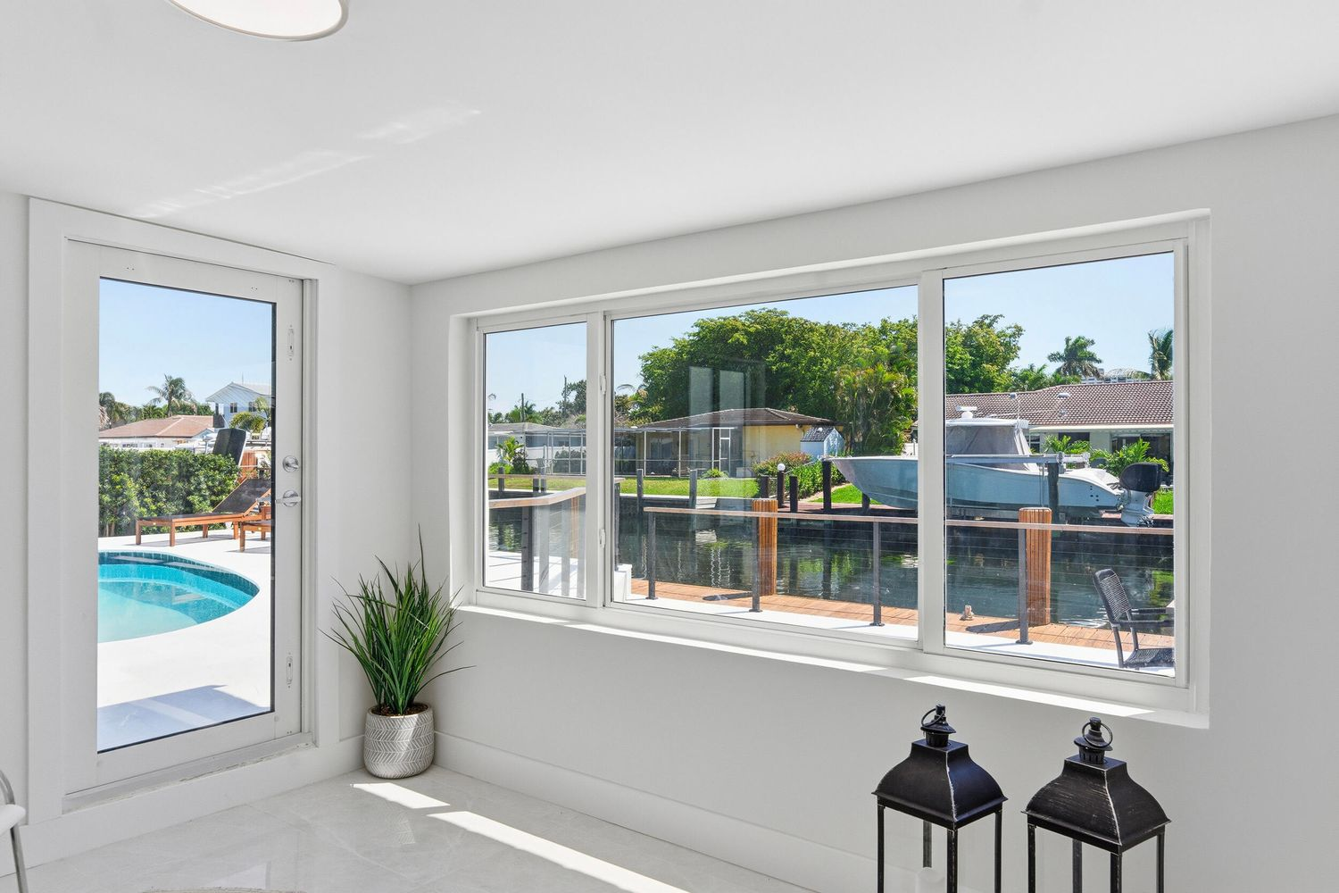
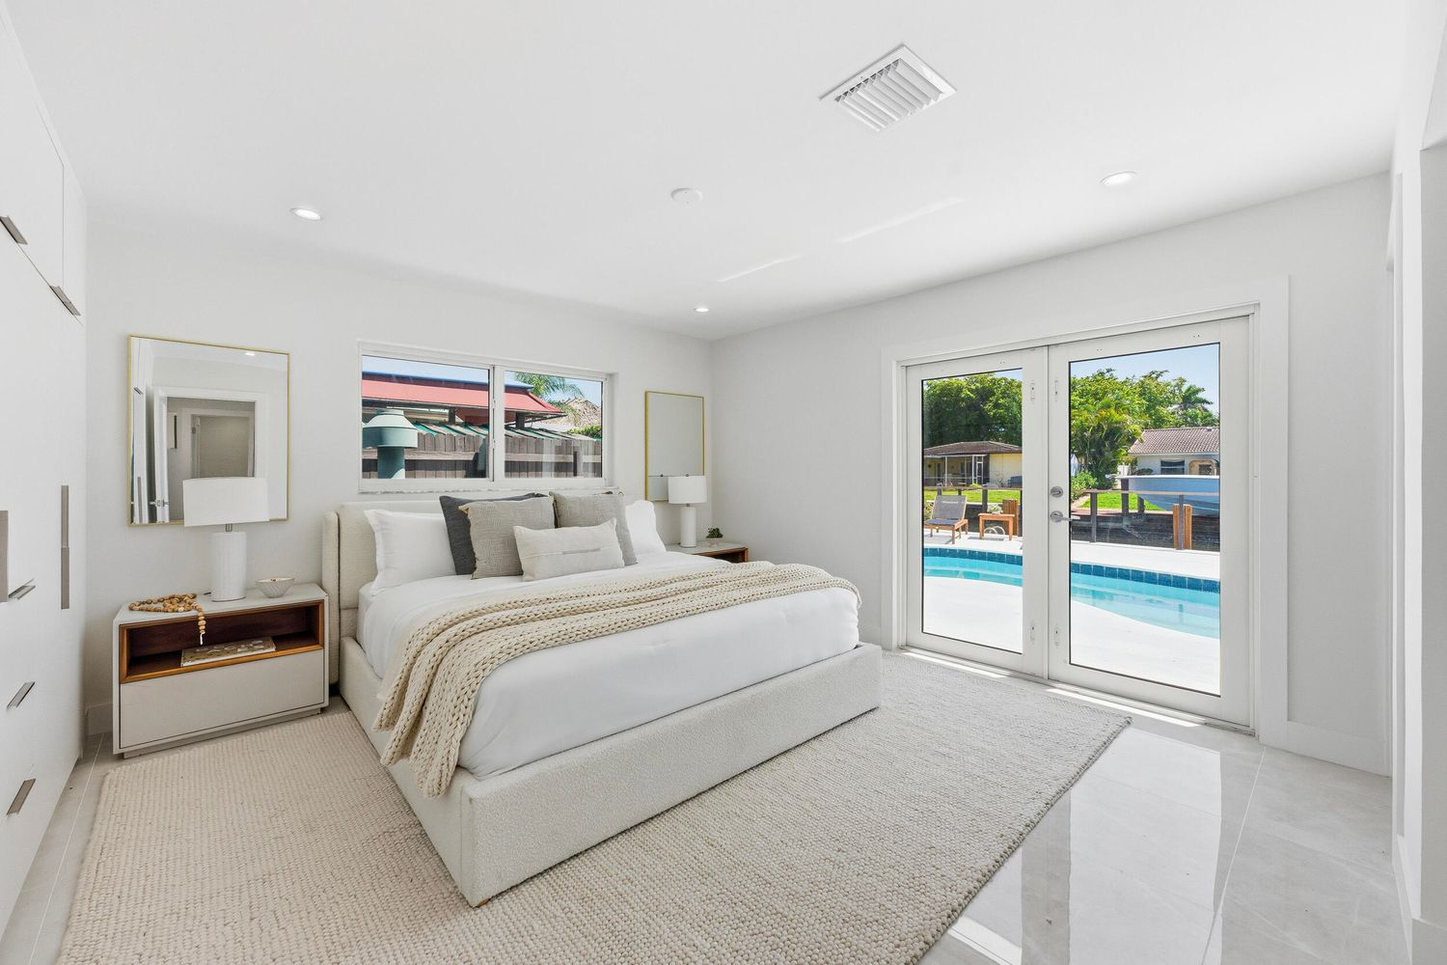
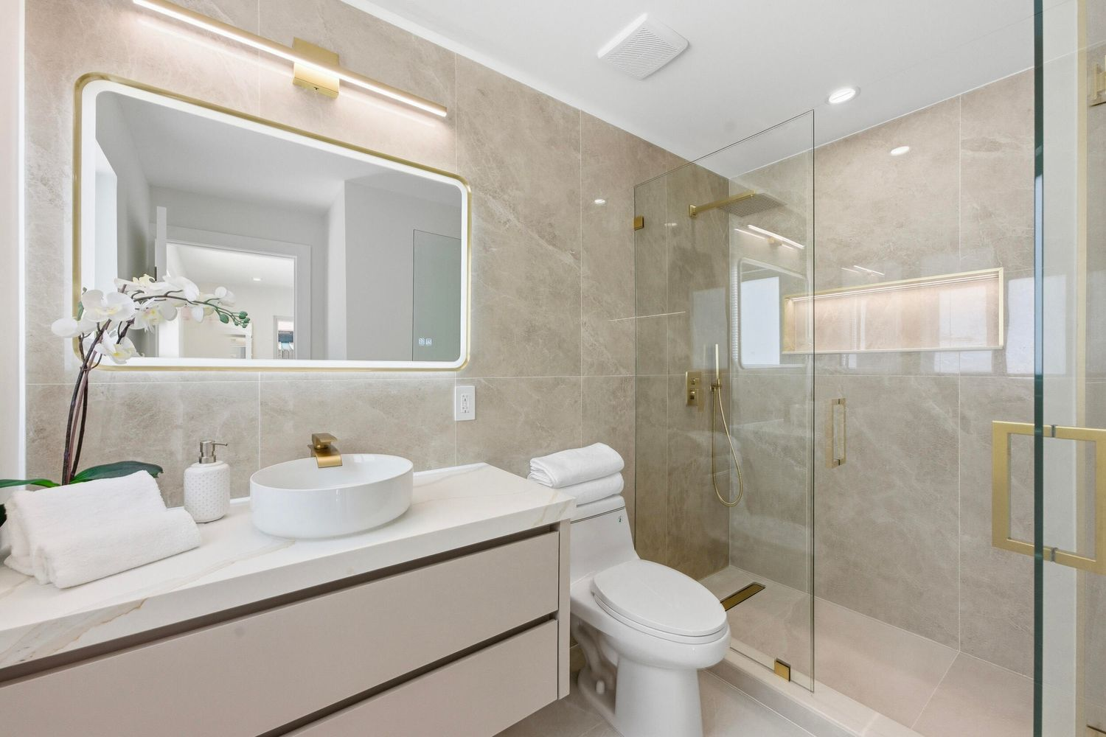
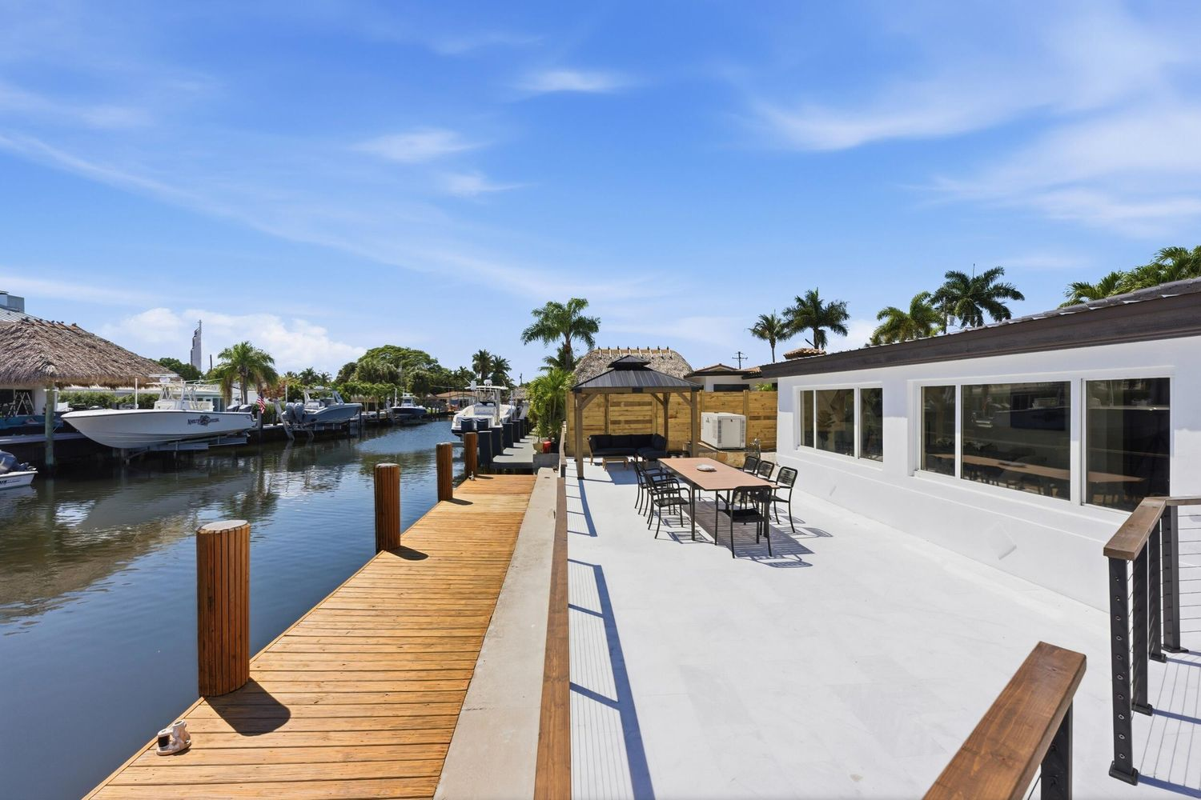
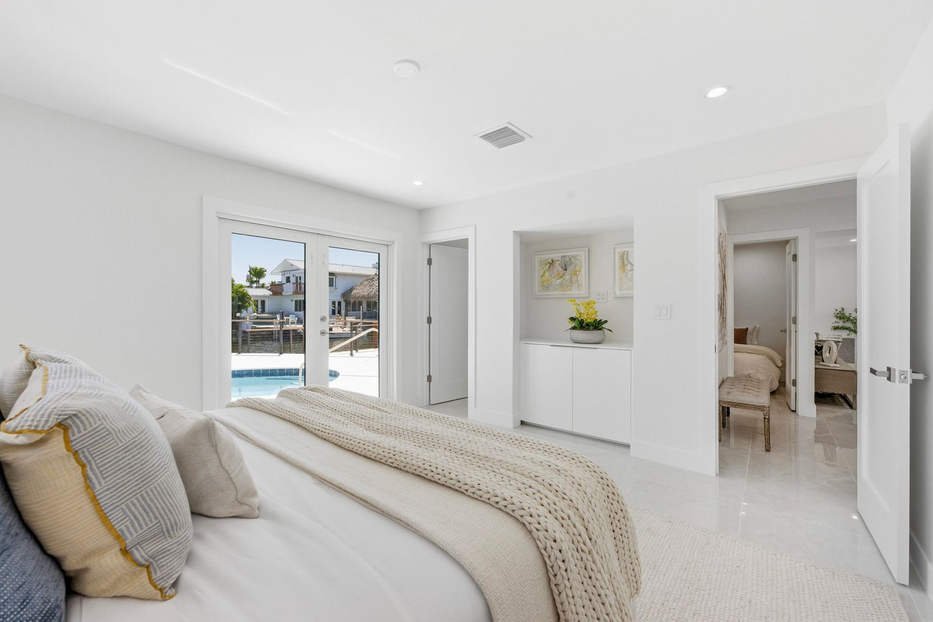
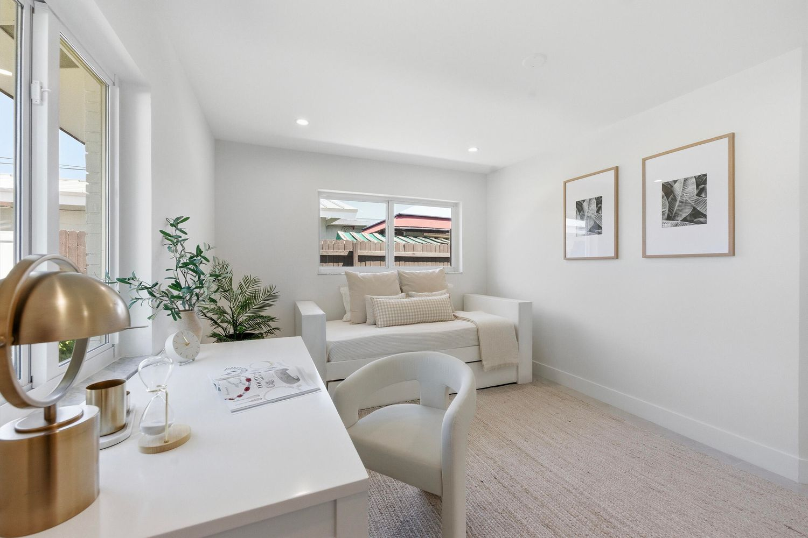
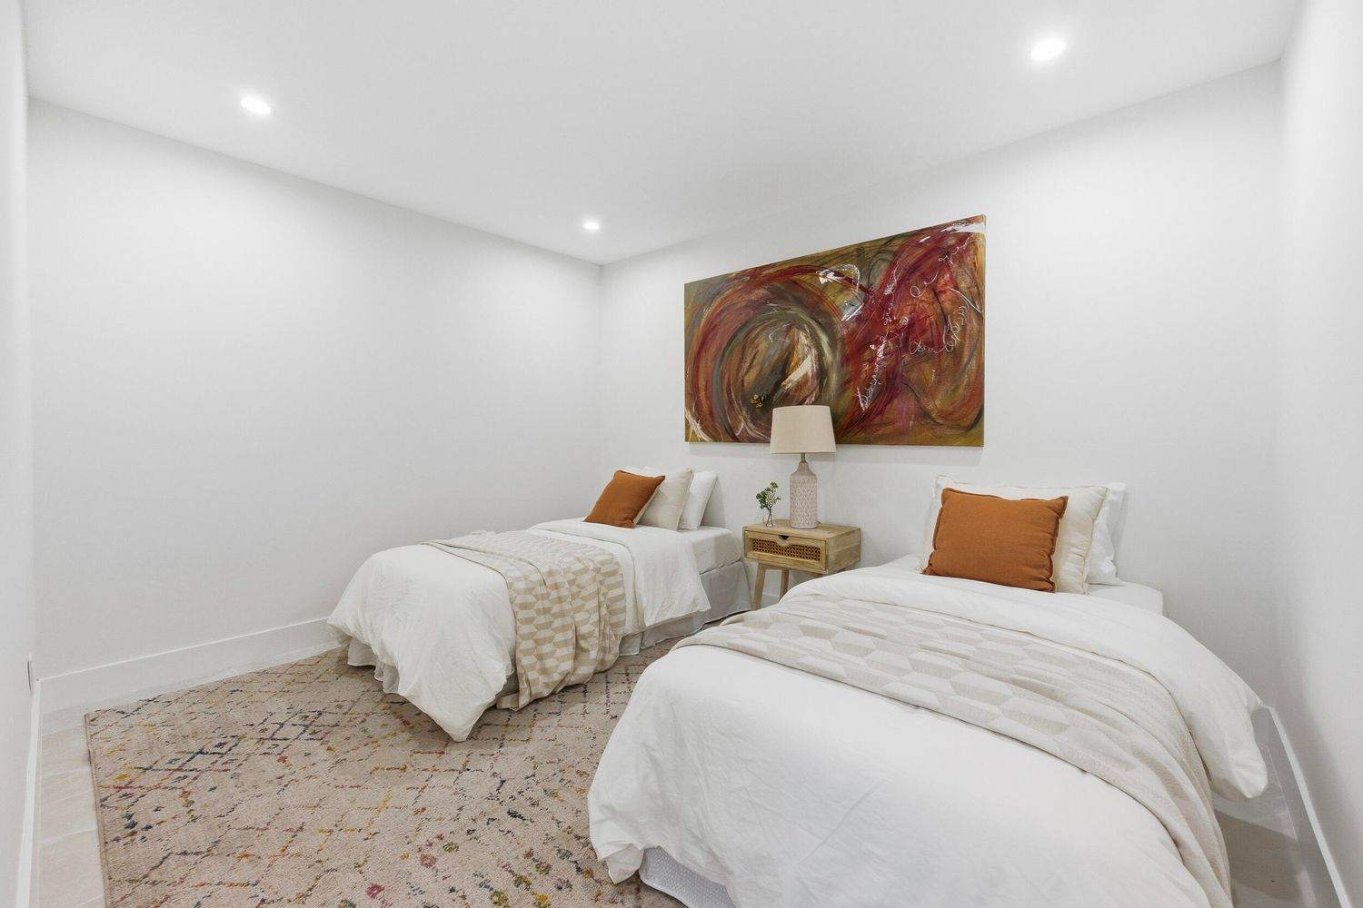
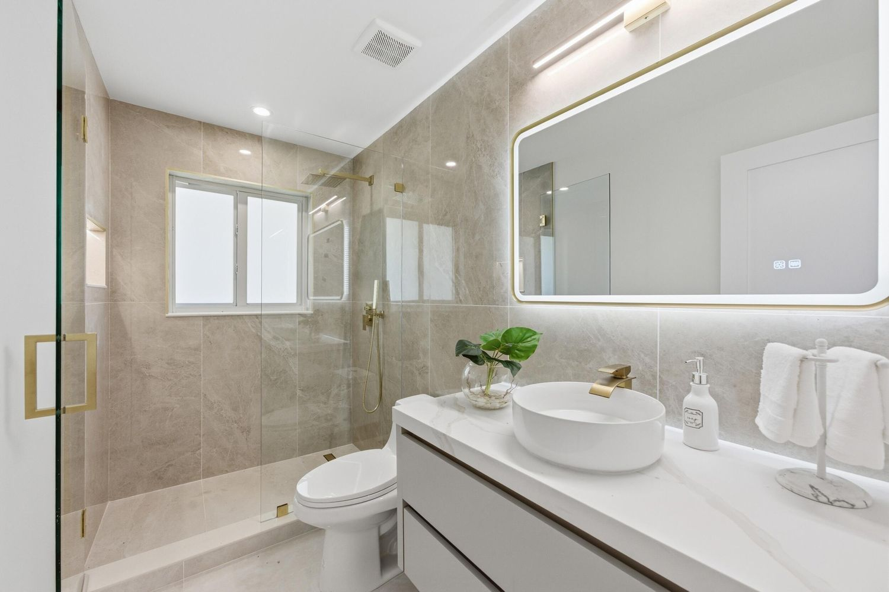
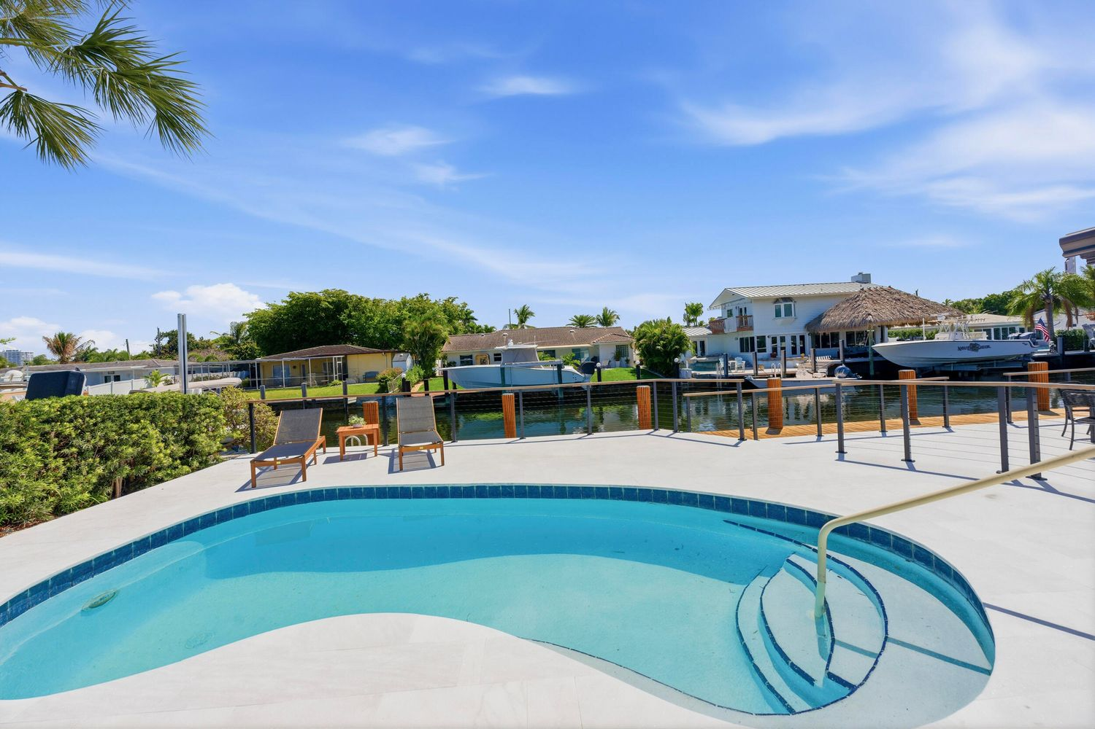
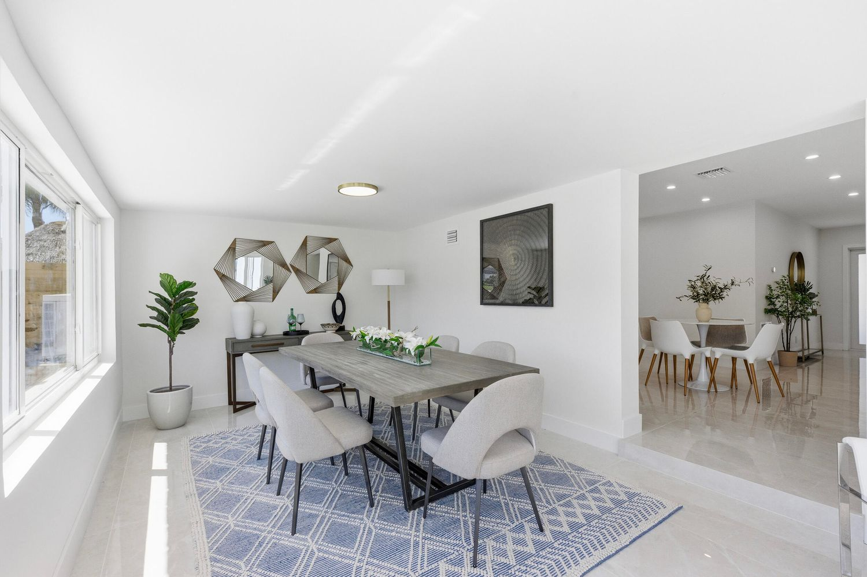
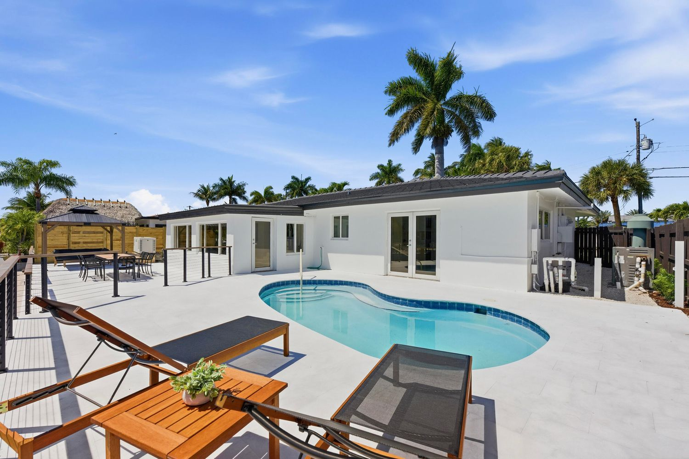
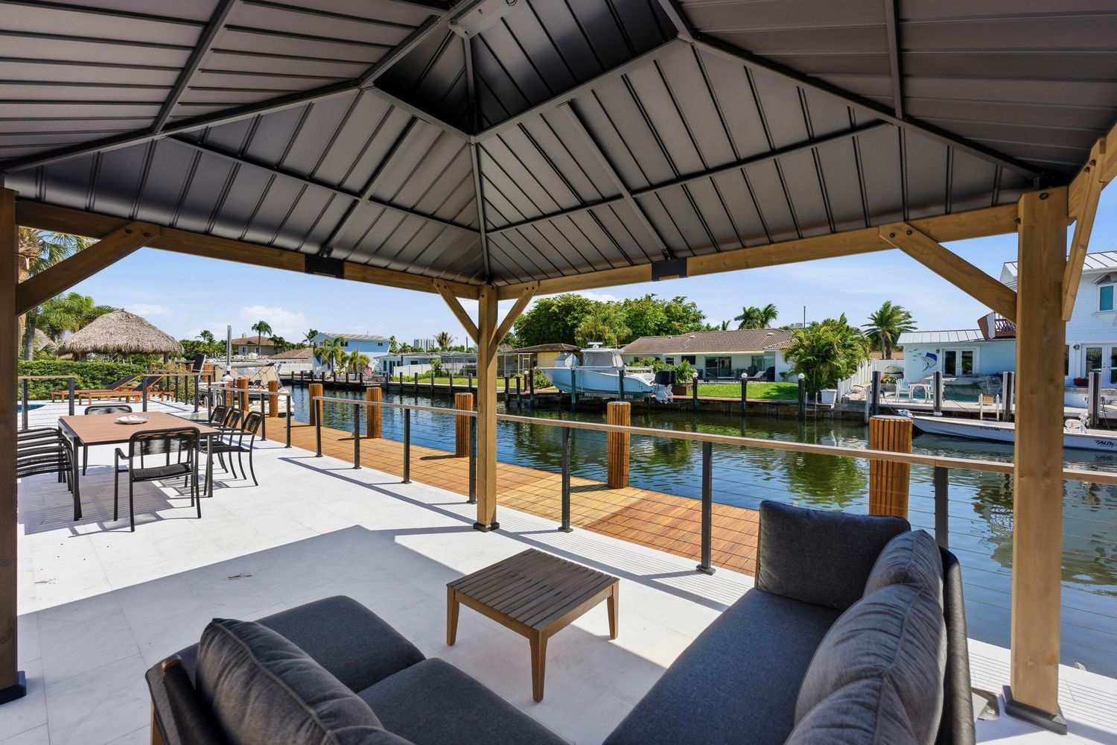
2280 SE 10th Ct Pompano Beach, FL 33062 AFTER
ARCSA CAPITAL | Confidential | For Qualified Investors Only

Slide 10
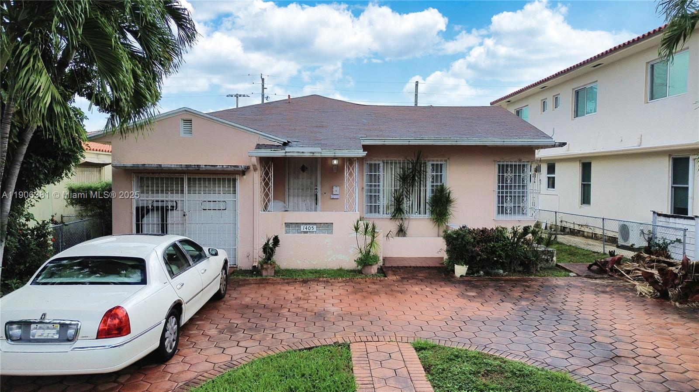
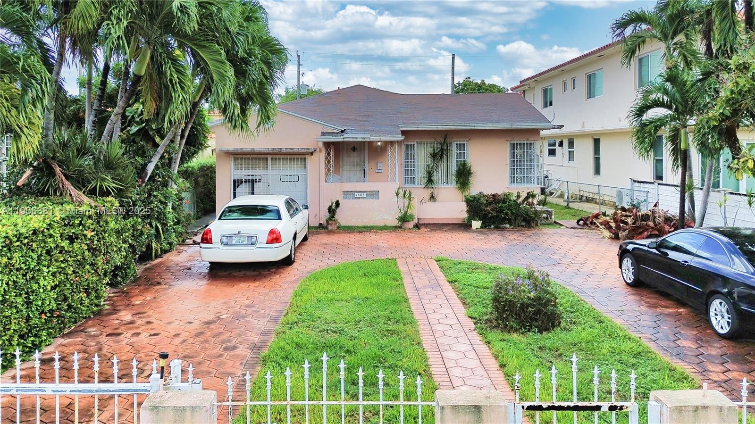










1405 Lenox Ave, Miami Beach, FL BEFORE
ARCSA CAPITAL | Confidential | For Qualified Investors Only

Slide 11












1405 Lenox Ave, Miami Beach, FL AFTER
ARCSA CAPITAL | Confidential | For Qualified Investors Only

Slide 12









1230 Pizarro St, Coral Gables, Fl 33134 Before
ARCSA CAPITAL | Confidential | For Qualified Investors Only

Slide 13













1230 Pizarro St, Coral Gables, Fl 33134 AFTER
ARCSA CAPITAL | Confidential | For Qualified Investors Only

